Slide 1
Mental Health Care for the Childcare Workforce
January 16, 2025

Slide 2
Community Need
There are 213 childcare programs in the city with a licensed capacity to serve a little more than 11,400 children. It is estimated that there are almost 2,250 childcare educators (teachers, aids, directors, admin, support roles) serving these children.
In 2024, all three MHB Early Childhood Funded Partners leading social-emotional development cohorts identified mental health support for childcare workers as a significant priority. This group represents 34 city childcare providers responsible for caring for more than 1,000 children birth to age five.
According to County Health Rankings, University of Wisconsin Population Health Institute, 2024, and US Census Bureau, Small Area Income and Poverty Estimates, the average City of St Louis resident admits to having:
4.3 poor physical health days per month
6.2 poor mental health days per month
18% of population experiences mental distress consisting of 14 or more days of poor mental health per month
The childcare workforce experiences mental health challenges at a higher rate than other professions. Using the City of St Louis numbers, almost 1 out of every 5 childcare educators are experiencing 14 or more days per month of poor mental health.

Slide 3
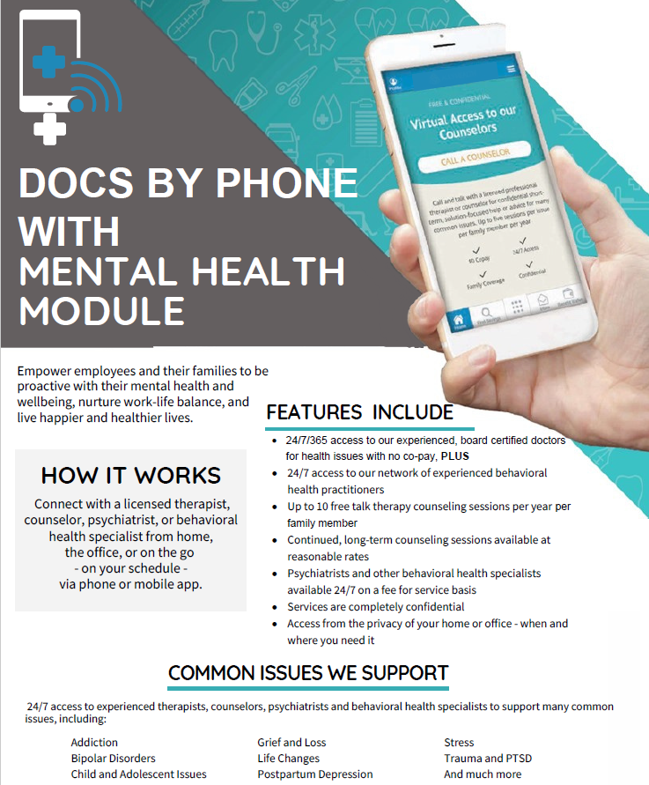

Program Design
Child Care Aware will provide access to telehealth/mental health services for 225 city childcare providers (approx. 10% of city childcare providers).
Childcare providers and their families will have access to up to 10 mental health visits at no cost to them.
Upon notice of award, Child Care Aware will begin recruitment and enrollment of childcare providers through existing partnerships.
Child Care Aware works closely with the vendor AllyHealth to achieve a 90% enrollment completion rate.
Childcare providers who do not complete the enrollment process are “dropped” to make room for providers who are on the waitlist to ensure full utilization of the available slots.

Slide 4

Program Goals
Provide health and mental health care for childcare professionals who may have high co-pays or may not otherwise have access to health / mental health support allowing some childcare professionals the ability to remain employed in childcare;
Create an affordable employment benefit for the childcare workforce who typically have no or insufficient health care insurance thus demonstrating the return on investment for childcare center owners / operators;
Support a healthier and more reliable childcare workforce that can provide more stability to the children in their care.

Slide 5
Program Evaluation
Child Care Aware, in coordination with AllyHealth, will track the following short-term goals:
75% of childcare providers will be enrolled in the first 60 days following grant award.
A customer satisfaction level of at least 85% will be maintained during the grant period.
MHB will use our traditional performance management contract that includes quarterly reporting and monthly payment disbursements to ensure appropriate programmatic and financial management.
Early Results
Child Care Aware has several small projects that have just started in Missouri serving 122 childcare providers across 27 programs. For these small pilots, 62.4% of those registered utilized services for behavioral health; 61% utilized behavioral health services two or more times; and 87% of the services were utilized by the childcare provider.
One state that utilizes this product has 1,870 active members registered and had a monthly utilization rate of 62.06% and a YTD utilization rate of 68.8%. Approximately 40% of the visits were from dependents. More than 40% of those utilizing telehealth / mental health services utilized two or more visits.

Slide 6
About AllyHealth and Child Care Aware
AllyHealth is a division of PES – An Employee Benefits Technology, Administration, Education & Virtual Care Solutions based in New Jersey.
AllyHealth has a network of U.S. Board Certified doctors with an average of over 15 years experience practicing medicine that are licensed in the state where patients are located. Their specialties include primary care, pediatrics, emergency medicine, and family medicine.
AllyHealth utilizes licensed therapists, psychologists, psychiatrists, and other behavioral health professionals to provide virtual sessions. Therapists have a variety of backgrounds and specialties so that clients can connect with the right provider.
Founded in 1999, Child Care Aware® of Missouri is a statewide nonprofit. The organization’s services include workforce development, childcare business supports, advocacy and policy work.

