Slide 1
Executive Director’s Staff Report
August 16 – September 19, 2024

Slide 2
Board & Staff
No Board Committee meetings other than the standing Executive Committee Meeting occurred
Welcome New MHB Staff!
  Xinyue Zhang, Data and Performance Analyst
  Justin Mosley, STL Area Violence Prevention Commission Project Director
Congratulations to Children’s Services Fund Project Director Denise Carter – UMSL Neighborhood Leadership Fellows Graduate
  Director of Prevention Partnerships Lisa Potts is also an alumnus of the program

Slide 3
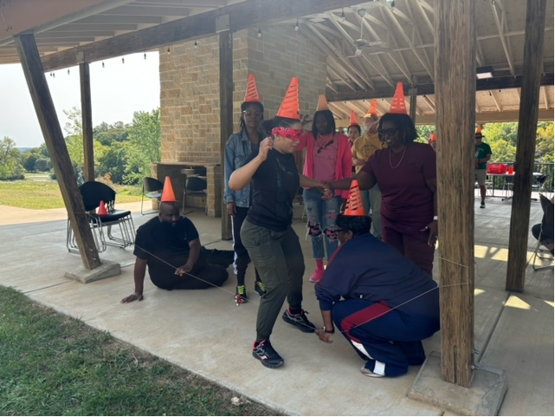
Staff Retreat at Camp Wyman – Sept. 10
Staff team building activities facilitated by Camp Wyman staff

Slide 4

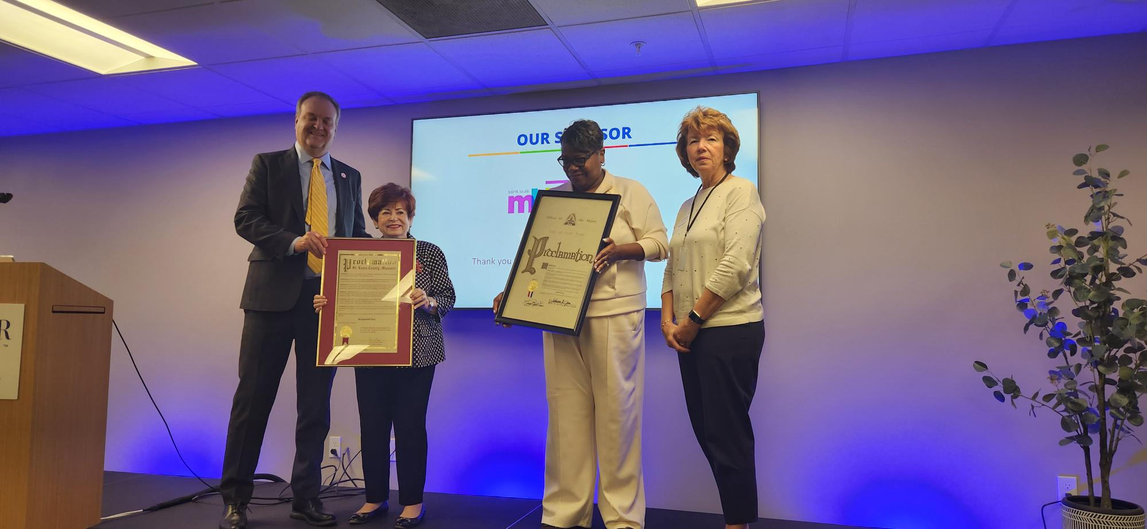
Community Investments/Allocations
FY25 Out-of-School Time RFP Process
Blueprint4Summer Camp Summit Sept. 18
MHB sponsors Camp Summit in partnership with
Clark-Fox Family Foundation co-lead by Denise Carter

Slide 5
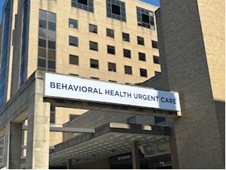
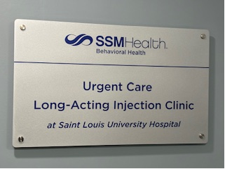
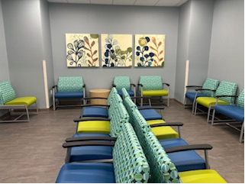
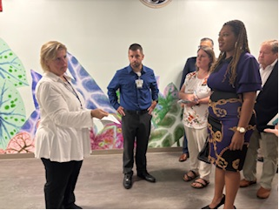
Former SLU Emergency Dept.
Places for People’s VP Barb
Zawier leads tours below
SSM Health and Places for People open Behavioral Health Urgent Care in Tiffany Neighborhood with MHB funding

Slide 6

Community Investments/Allocations cont’d.
MHB awards House Everyone STL $10K from the CCSF Emerging Needs Fund to increase the number of winter emergency shelter beds for children & youth ages 18 and younger
Phase I of the Community Health Needs Assessment is nearing completion – 2 virtual sessions are scheduled Oct. 28 (12 – 1 PM) & Oct. 29 (5:30 – 6:30 PM) for shared interest partners to provide feedback on the highlights, trends and initial findings from quantitative data gathering

Slide 7
Wellness in Neighborhoods Public Awareness Campaign Awards $5K Grants to 4 Wards
Ward 8 in the LaSalle Park Neighborhood – Employment Connection will cohost National Night Out, Music on the Mall, and Kickball Games between August 24 – October 31, 2024.
Ward 9 in the Central West End Neighborhood – MPRINT Community Wellness will facilitate six Breakfast Roundtable Depression Groups focused on adults ages 55 and older between August 24, 2024, and January 25, 2025.
Ward 3 in the Dutchtown Neighborhood – Thomas Dunn Learning Center will host an Autumn Chill Event for approximately 400 participants on October 12, 2024.
Ward 13 in the Mark Twain Neighborhood – Walnut Park Community Outreach will host a Fall Festival Wellness Event October 19 or October 26, 2024, for approximately 120 participants.

Slide 8
Federal Programs/Strategic Initiatives
St. Louis Region System of Care Year One Site Visits – Poli Rijos, Director of Youth Development Partnerships, completed the System of Care site visits with grant partners to discuss programmatic progress and plan for year two.
St. Louis Area Violence Prevention Commission BJC Violence Prevention Meeting – Deputy Director Serena Muhammad, was invited to participate in a strategic planning session for the BJC Community Health Improvement team. They have identified violence prevention as a priority and sought input from key partners to help refine their strategy.

Slide 9
Administration
Work has begun on the FY24 Annual Report
Accounting staff have completed the FY24 year-end close and begun early work for the FY24 audit
New staff headshots are scheduled for Oct. 22 from 9 – 11 AM. Any Trustee that would like an updated photo for the website is welcome to come have their photo taken. Photos will be taken outside.

