Slide 1
Board of Trustees Orientation
Part 1

Slide 2
Orientation Topic Areas
Overview and History
Legal Issues:
Statutes
Legal Issues:
Sunshine Law
Legal Issues:
Board Policies
Legal Issues:
By-Laws
Strategic Plan and Theory of Change
Trustee
Duties & Responsibilities
Board Committees
Financial Overview
Staff
Community Investments & Strategic Initiatives
Allocations & Grant Making

Slide 3
Overview and History

Slide 4
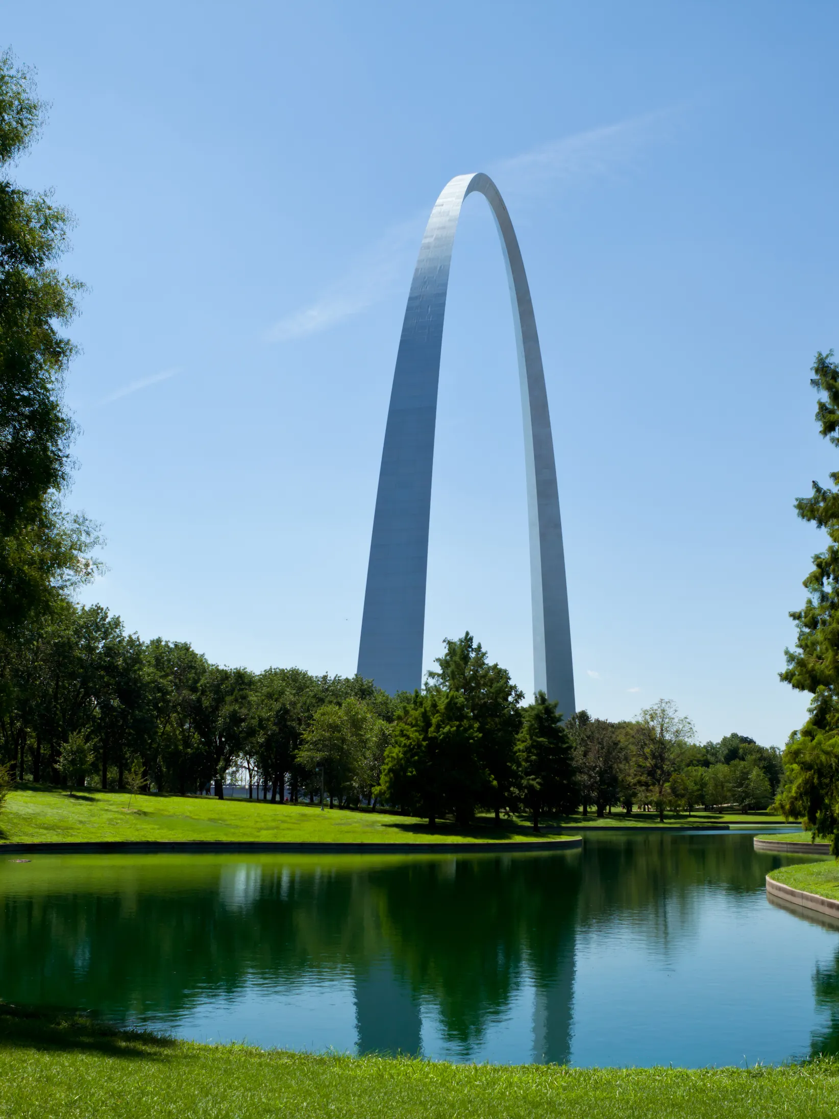
Vision, Mission, Values
MHB’s vision is to be a strategic visionary leader investing in and strengthening an integrated system of social, behavioral, and physical health services to build an equitable, thriving community.
We’re on a mission to improve the quality of life for city residents by investing and participating in a coordinated system of social, behavioral, and physical health services aligned with community priorities.
Values
Stewardship and Accountability
Person-Centered
Collaborative Leadership
Excellence
Effectiveness Through Learning Measurable Impact
Photo image from Architectural Digest
Notes:
Values
Stewardship and Accountability – Because MHB resources are made possible through taxes paid by residents and property owners in the City of St. Louis, MHB is committed to ensuring those resources are used wisely. This means that records are accurate, expenditures are planned and made according to a Board-approved budget, systems are efficient, effective, and transparent, and both Trustees and Staff are prepared to fulfill their roles and possess diverse perspectives so that funding decisions are given consideration from multiple lenses with the goal of creating an equitable community.
Person-Centered – MHB believes that it is our job to ensure that the programs in which we invest, achieve the best results possible for the people being served. Therefore, it is important MHB-funded projects focus on accessibility, responsiveness, and effectiveness at making change in the well-being of the people they serve. In short, participant benefit—not simply program activities—should be the center of their work.
Collaborative Leadership – MHB operates from the assumption that no single entity or person has the resources or is capable of achieving community/population-level goals. Therefore, we believe better results will be achieved when we work with other organizations or individuals to address our common goals.
Excellence – MHB holds itself to the highest standards in all that we do; from our published materials, our relationships with peers, funded organizations, and each other; and our internal systems and operations.
Effectiveness through Learning – MHB believes that we must be engaged in a continuous learning process in order to remain informed and up to date on new knowledge, trends, and environmental changes that affect our work.
Measurable Impact – All the work that is done by, and through MHB must ultimately achieve “real” impact. This impact must be quantifiable using data collected and analyzed so that progress with respect to social/behavioral problems addressed can be tracked, and that when we claim success, it must be because the data supports it.

Slide 5
Brief History
1992 – Voters approve Community Mental Health Fund (CMHF) mil tax – $0.09 of every $100 assessed property value
January 1994 – MHB established with two employees (Don Cuvo, founding Executive Director)
March 1997 – First Community Children’s Services Fund (CCSF) ballot initiative fails
2004 – First federal grant award; voters approve CCSF mil tax $0.19 of every $100 assessed property value
2012 – Retiring Executive Director Don Cuvo succeeded by Jama Dodson
November 2020 – Voters approve $0.06 increase to CCSF tax reaching the statutory ceiling of $0.25 of every $100 assessed property value
July 2021 – Retiring ED Jama Dodson succeeded by Deputy Director Cassandra Kaufman
July 2023 – MHB offices move from Union Station in Downtown West to Peabody Plaza in Downtown
Notes:
1st ORR grant

Slide 6
Name | Employer | Neighborhood | Email | Phone | Term
Andrea Blaylock, LCSW, CEAP, SAP | Emerson | DeBaliviere Place | andiblaylockstl@gmail.com | 773.771.1692 | 12/31/2025
Terrell Carter, DMin Board Chair & Housing Committee Chair |  | Lindenwood Place | terrellcarter@msn.com | 314.704.9111 | 04/30/2024
Vander Corliss, MAcc | United Way of Greater St. Louis | Downtown | vander.corliss@stl.unitedway.org | 314.610.4770 | 12/31/2022
Linda Grayson, Personnel Committee Chair | May Company (Retired) | Central West End | graysonlc@aol.com | 314.550.2769 | 04/30/2024
Ronald Griffin, MHA, BSN, RN | St. Louis County Department of Health | Penrose | rcgriffin1@hotmail.com | 314.766.0387 | 04/30/2024
Mario Hamell, BA | Parallon | Gravois Park | mlhfg8@yahoo.com | 314.458.8203 | 04/30/2024
Marcia Hayes-Harris, MA | Beyond Housing | West End | mhvelt74@gmail.com | 314-348-5478 | 12/31/2026
Carolyn Jackson, MA Nominating Committee Chair | Confluence Academy | Enright | emmonstravel@yahoo.com | 314.210.9240 | 12/31/2024
Julia López, PhD, MPH, LCSW Program Committee Chair | Washington University School of Medicine | Forest Park Southeast | julialopez@wustl.edu | 314.704.6770 | 12/31/2024
Lisa Mulligan, MSW | Girls on the Run St. Louis | Shaw | lisa@gotrstl.org | 314.922.6587 | 12/31/2024
Cassandra Pinkston, MPA | Higher Education Consortium of St. Louis | Shaw | cpinkston@hecstl.org | 314.397.5687 (Home) | 12/31/2022
Robert Poirier, MD, MBA Secretary/Treasurer & Finance—Investment Committee Chair | Washington University School of Medicine | Central West End | poirierr@wustl.edu | 314.761.7252 | 12/31/2022
Donna Schmitt, JD Vice Chair | Armstrong Teasdale, LLP | St. Louis Hills | dschmitt@atllp.com | 314.202.1643 | 12/31/2024
Janice Thomas, BS | VOYCE | Skinker-DeBaliviere | jsthomas591@gmail.com | 314.412.6473 | 03/25/2026

Slide 7
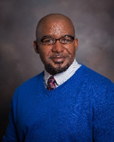
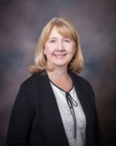
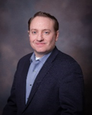
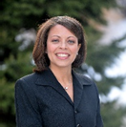

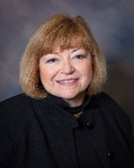

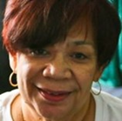
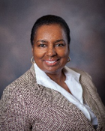
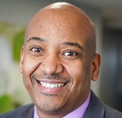
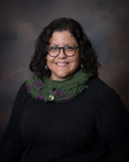

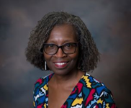
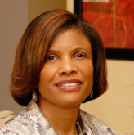
MHB Trustees
Chair
Vice Chair
Secretary/Treasurer
Terrell Carter
Donna Schmitt
Rob Poirier
Andi Blaylock
Vander Corliss
Linda Grayson
Ronald Griffin
Mario Hamell
Marcia Hayes-Harris
Carolyn Jackson
Julia López
Lisa Mulligan
Cassandra Pinkston
Janice Thomas

Slide 8
Legal Issues:
Statutes

Slide 9
Community Mental Health Fund Statute
Title XII Public Health and Welfare Chapter 205
Sections 205.975 – 205.989
“Comprehensive
Mental Health Services”
inpatient services
outpatient services
day care and other partial hospitalization services
emergency services
diagnostic and treatment services
liaison and follow-up services
consultation and education services
rehabilitation services
prevention services
screening services
follow-up care services
transitional living services
alcoholism and alcohol abuse prevention and treatment services
drug addiction and drug abuse prevention and treatment services
DMH Certification
Accreditation = certification
  CARF International
  Joint Commission
  Council on Accreditation

Slide 10
Community Children’s Services Fund Statute
Title XII Public Health and Welfare Chapter 210
Sections 210.860-210.861
up to thirty days of temporary shelter for abused, neglected, runaway, homeless or emotionally disturbed youth
respite care services
services to unwed mothers;
outpatient chemical dependency psychiatric treatment programs
counseling and related services as a part of transitional living programs
home-based and community-based family intervention programs
unmarried parent services
crisis intervention services, inclusive of telephone hotlines
prevention programs which promote healthy lifestyles among children and youth and strengthen families
individual, group, or family professional counseling and therapy services
psychological evaluations; and mental health screenings.
Restrictions on Use:
Revenues collected and deposited in the community children's services fund may not be expended for inpatient medical, psychiatric, and chemical dependency services, or for transportation services.

Slide 11
Legal Issues:
Board Policies

Slide 12
Duties of the Board
Policy making body responsible for the operations of the St. Louis Mental Health Board and Community Children’s Services Fund
Set tax rates annually for both funds (September)
Approve Ethics Resolution every other even-numbered year so that Executive Director is the only person required to file an annual financial disclosure (June)
Approve budget annually (June)

Slide 13
Code of Ethics – Conflicts of Interest
Board
Staff
Cannot have a financial interest or have a relative who has a financial interest in an entity with which MHB contracts
Cannot accept services or gifts from a contracted organization
Cannot accept a policymaking, administrative or consulting position with a contracted agency or one seeking a contract
Cannot provide training or technical assistance on application preparation other than that provided to all applicants as part of the application process
Cannot volunteer for funded agencies, promote fund raising events of funded agencies, become overly familiar with key staff of funded agencies, and socialize after hours
Should not make overtly laudatory or pejorative public commentaries about a funded agency’s performance
Per CCSF statute cannot:
Serve on the board of any recipient entity
Have a financial interest in
Be employed by recipient entity
Per CMHF statute cannot:
Be employed by recipient entity

Slide 14
Other Board Policies
Nepotism – Board shall not employ any of its members or any person related within the 4th degree
Remuneration & Reimbursement—Trustees may be reimbursed for actual expenses in performance of official duties
Public & Closed Meetings/Executive Sessions (Sunshine Law)
Notification of Public Meetings (Sunshine Law)
Custodian of Records (Sunshine Law)
Notes:
The board shall not employ any of its members nor shall it employ any person who is related within the 4th degree to any board member, either by consanguinity or affinity, where the vote of the trustee is necessary for the appointment of the person.
In the event that the individual is recommended for appointment by the executive director and the individual is related within the 4th degree to a trustee of the board, the trustee shall declare his/her interest and refrain from debating or voting upon the question of appointment.

Slide 15
Communications with the Public –
Community Comments
Citizens are invited to attend any and all Board meetings (and Board Committee meetings) and raise issues of concern before the meeting begins
  All speakers will receive a written response at a later date, although the Chair may respond to issues raised at the time of the meeting
Public may not participate during the actual meeting
Up to 3 members of the public will be allowed to speak on a particular subject
Each person may speak for up to 3 minutes
Members of the public may speak in the order in which they signed up
To retain decorum and order, the Board retains the right to deny any member of the public the opportunity to speak at a meeting
Notes:
The board shall not employ any of its members nor shall it employ any person who is related within the 4th degree to any board member, either by consanguinity or affinity, where the vote of the trustee is necessary for the appointment of the person.
In the event that the individual is recommended for appointment by the executive director and the individual is related within the 4th degree to a trustee of the board, the trustee shall declare his/her interest and refrain from debating or voting upon the question of appointment.

Slide 16
Other Board Policies
Meeting attendance – 3 unexcused absences within a year constitute de facto resignation
Nominations – Mayor’s office submits nominations to the Board of Aldermen for approval
Terms – 3 years, unless filling unexpired term; may be reappointed
Notes:
The board shall not employ any of its members nor shall it employ any person who is related within the 4th degree to any board member, either by consanguinity or affinity, where the vote of the trustee is necessary for the appointment of the person.
In the event that the individual is recommended for appointment by the executive director and the individual is related within the 4th degree to a trustee of the board, the trustee shall declare his/her interest and refrain from debating or voting upon the question of appointment.

Slide 17
Legal Issues:
Sunshine Law

Slide 18
Sunshine Law – Top 10 Things You Should Know
When in doubt, a meeting or record of a public body should be opened to the public.
The Sunshine Law applies to all records, regardless of what form they are kept in, and to all meetings, regardless of the manner in which they are held.
The Sunshine Law allows a public body to close meetings and records to the public in some limited circumstances, but it almost never requires a public body to do so.
Except in emergency situations, a public body must give 24 hours’ public notice before holding a meeting. If the meeting will be closed to the public, the notice must state the specific provision within Section 610.021, RSMo., that allows the meeting to be closed.
Each public body must have a written Sunshine Law policy and a custodian of records whose name is available to the public upon request.

Slide 19
Sunshine Law Top 10 Cont’d.
The Sunshine Law requires a custodian of records to respond to a records request as soon as possible but not later than three business days after the custodian receives it.
The Sunshine Law deals with whether a public body’s records must be open to the public, but it generally does not state what records the body must keep or for how long. A body cannot, however, avoid a records request by destroying records after it receives a request for those records.
The Sunshine Law allows for public meetings to be both audio and video recorded by attendees. Each public governmental body may set up guidelines regarding the recording process. These guidelines can be found in the body’s Sunshine Law policy. No one is allowed to record a closed meeting, if they are not given permission to do so.
When responding to a request for copies of its records, the Sunshine Law limits how much a public body can charge – per page, and per hour – for copying and research costs.
There are specific provisions governing access to law enforcement and judicial records.

Slide 20
Sunshine Law – Other Considerations
1973—Missouri was an early adopter
Limited circumstances when meetings, records & votes may be closed
In-person, phone, and virtual meetings must be held at reasonably convenient times and be accessible to the public
Subcommittees are also covered by the law
Notices of open meetings must contain the date, time, place, and tentative agenda
Notices of closed meetings must:
  contain the date, time, and place of the meeting
  state specific reason in Section 610.021, RSMo., that allows for closure
  only business directly related to the reason for closure may be discussed
    roll call votes must be taken
  Custodian of Records = MHB Executive Director
Notes:
In-person, phone, and virtual meetings must be held at reasonably convenient times and be accessible to the public
Held in facilities large enough to accommodate the public and accessible to persons with disabilities

Slide 21
Sunshine Law – Other Considerations
“Meeting” occurs when a majority or quorum of a public governmental body gathers to discuss or vote on public business—if less than a quorum meets to discuss public business, it is not a “meeting”
Minutes must record the date, time, and place of the meeting, the members present and absent, and records of all votes taken
Topics about which members of the public did not receive at least 24 hours’ notice should not be discussed
Public governmental bodies are required to allow recording at open meetings
Recording a closed meeting without permission of the public governmental body is a class C misdemeanor
Notes:
Each public governmental body must have a written Sunshine Law policy available to members of the public, and a Custodian of Records whose name is available to the public upon request.
Notice of all meetings must be posted at least 24 hours in advance. If the meeting will be conducted by telephone, or by other electronic means, the notice must identify how the meeting will be conducted, as well as instructions explaining how the public may observe.
Notices of open meetings must contain the date, time, place, and tentative agenda of the meeting.
Notices of closed meetings must contain the date, time, and place of the meeting, and the specific reason in Section 610.021, RSMo., that allows for closing the meeting. In closed meetings, only business directly related to the reason for closure may be discussed. Roll call votes must be taken on the motion to close a meeting, and each vote during a closed meeting must be a roll call vote, with each vote recorded in the meeting minutes.

Slide 22
Sunshine Law – Other Considerations
Does not require that members of the public be permitted to speak at meetings
Email
  a single e-mail about an issue would not in and of itself constitute a meeting requiring advance notice
  any member of a public governmental body who sends an e-mail relating to public business to a majority of the body shall also send a copy to the custodian of records (Executive Director) to be retained as a public record
Notes:
Meeting minutes must record the date, time, and place of the meeting, the members present and absent, and records of all votes taken. Topics about which members of the public did not receive at least 24 hours’ notice should not be discussed during the meeting, unless it is impossible or impractical to provide 24 hours’ notice, in which case the reason for not providing 24 hours’ notice must be noted in the minutes.
Public governmental bodies are required to allow recording at open meetings, though they may set rules within their Sunshine Law policy to minimize disruption. Recording a closed meeting without permission of the public governmental body is a class C misdemeanor.
While the Sunshine Law mandates that most meetings of public government bodies shall be open to the public, it does not require that members of the public be permitted to speak at these meetings.
The Custodian of Records must respond to requests within three business days, by: (1) providing the requested records; (2) informing the requestor that the records sought are closed, and citing the proper provision for closure; or, (3) explaining the cause of the delay and estimating when the records will be provided. The day a request is received by the Custodian of Records does not counts as one of the three business days. The time for providing access may exceed three business days for reasonable cause.

Slide 23
Legal Issues:
By-Laws

Slide 24
By-Laws
Name – St. Louis Mental Health Board or Mental Health Board
Purpose
  Mental Health Board Activities
    Providing necessary funds to establish, operate, and maintain community mental health centers, mental health clinics, or any comprehensive mental health services; and
    Providing funds to supplement existing funds for the operation and maintenance of community mental health centers, mental health clinic, or any comprehensive mental health services; and
    Purchasing any of the comprehensive mental health services from community mental health centers, mental health clinics, and other public facilities or not-for-profit corporations which are designated by the department.
  Community Children’s Services Fund Activities
    To provide funds for counseling and related services to children and youth which will promote healthy lifestyles and strengthen families, as provided pursuant to Section 210.801 RSMo. 2004 as may be amended.

Slide 25
By-Laws
Board Composition
  Not less than 9 and no more than 15 members
  1/2 not health services providers
  Licensed physician
  No more than 1/3 may be service providers
  At least 1/3 represent consumers of psychiatric services or families of consumers
  Representative of city residents taking into consideration race, age, sex, place of residence, and other demographic characteristics
Officers – Chair, Vice Chair, Secretary/Treasurer elected annually for 1-year term
Parliamentary procedure – Robert’s Rules of Order
Ethics Policy

Slide 26
By-Laws
Meetings
  Monthly; special meetings may be called by Chair (NOTE: Board does not typically meet in December and July)
  Quorum = simple majority
  Meetings may be held using communication equipment but must be accessible to the public
Voting
  Chair is voting member
  Majority required to pass any measure
  Recusal
  Abstention
Staff
Notes:
Staff
The Board of Trustees share hire an Executive Director, who shall be responsible for carrying out the responsibilities and business of the Board of Trustees in conformity with all policies of the Board, including but not limited to, the hiring, firing, demotion/promotion, discipline, and supervision of employees.
The staff of the Board of Trustees shall comply with the policy set forth by the Board of Trustees.
Staff position descriptions shall be developed and updated for all staff positions and shall be approved by the Board of Trustees.

Slide 27
By-Laws
Committees
  3 standing = Executive, Nominations, Personnel (Chair appoints, confirmed by majority of a quorum)
  3 ad hoc = Finance—Investment, Program, Housing
  Chair may appoint members to committees as necessary to conduct Board’s business, upon approval of a majority of a quorum
Executive Committee
  Purpose – to study, review and consider such matters as may be assigned by the Board including but not limited to litigation, potential litigation, contracts, and fiscal matters; authorized to plan upcoming Board meetings, act upon matters in urgent circumstances, and to conduct unanticipated essential business
  Composition – 3 Board officers (Legal Counsel and Executive Director attend)
  Meeting Schedule – monthly on the second Tuesday at 2:00 PM via Zoom

Slide 28
By-Laws
Nominating Committee
  Purpose – nominate persons to serve as officers and to solicit and screen nominees as potential members
  Composition – 3 Trustees appointed by the Chair at the January meeting (Chair is ex-officio, Executive Director attends)
  Meeting Schedule – at least once following January meeting to recommend Officer slate; as needed basis to fill unexpired terms or other Trustee vacancies
Personnel Committee
  Purpose – review, study, and consider personnel matters and matters affecting the staffing of MHB
  Composition – not less than 3 Trustees appointed by the Chair (Legal Counsel attends as needed, Executive Director attends)
  Meeting Schedule – as needed basis, but at least twice per year

Slide 29
By-Laws
Finance—Investment
  Purpose – Ad hoc committee formed to oversee the financial well-being of MHB, ensuring good stewardship of public funds and investments made to the community
  Composition – at least 3 Trustees, one of which is the Secretary/Treasurer (Legal Counsel, Executive Director, Deputy Director, and Controller attend)
  Meeting Schedule – at least quarterly to review financial, proposed annual operating budget, draft audit; may be convened on as needed basis
Housing Committee
  Purpose – Ad hoc committee formed to oversee the administration of Permanent Supportive Housing Fund from CMHF
  Composition – 3 Trustees and 3 community volunteers with specific expertise (Legal Counsel, Executive Director, Director of Clinical Partnerships, Executive Assistant attend)

Slide 30
By-Laws
Housing Committee cont’d.
  Meeting Schedule – as-needed basis to review Letters of Intent and determine whether applicant should be invited to submit a full application; reconvene after application is received to review, discuss, and vote on whether to bring the project to a full Trustee vote at an upcoming meeting
Program Committee
  Purpose – Ad hoc committee formed to provide guidance, advisement, and oversight to support the successful implementation and continuous quality improvement of MHB’s community investment strategy and approach
  Composition – at least 3 members and no more than 5 members, 3 of which are Trustees recommended by the Nominating Committee; membership may be expanded to include other community members with specific subject matter expertise and experience as desired by MHB staff and Trustees; Chair appointed by Board chair for two, 1-year renewable terms (Executive Director, Deputy Director and other Program Staff as appropriate)
  Meeting Schedule – as needed basis, but at least twice annually

Slide 32
Financial Overview

Slide 33
Budget
Fiscal year = July 1 – June 30
Complete financial plan for ensuing fiscal year for both CMHF and CCSF revenues and expenditures
Tax fund budgets and accounts may not be comingled; cost allocation for shared expenses
Includes:
  Description of important features and major changes from preceding year
  Estimated revenues to be received with comparative statement of actual or estimated revenues for next year itemized by year, fund, source
  Proposed expenditures for each classification for budget year with comparative statement of actual or estimated expenditures for next year, itemized by year, fund, activity, object
  General budget summary

Slide 34
Budget cont’d. & Other Financial Information
Expenditures may not exceed estimated revenues plus any unencumbered balance
Trustees may revise, alter, increase or decrease items in the budget subject to limitations provided by law, however changes require a revised budget and approved resolution
Approve budget annually prior to beginning of fiscal year
Budget resolutions must be reflected in minutes and remain on file for 3 years; constitute public open records
Combined operating fund
Investment Policies – follow guidance of Missouri State Treasurer

Slide 35
FY2024 Total Revenue $19,281,291

Slide 36
Fy2024 Total Expenses $19,232,137

