Slide 1
Board of Trustees Orientation
Part II

Slide 2
Orientation Topic Areas
Overview and History
Legal Issues:
Statutes
Legal Issues:
Sunshine Law
Legal Issues:
Board Policies
Legal Issues:
By-Laws
Strategic Plan and Theory of Change
Trustee
Duties & Responsibilities
Board Committees
Financial Overview
Staff
Community Investments & Strategic Initiatives
Allocations & Grant Making
Notes:
CASSANDRA

Slide 3
Strategic Plan &
Theory of Change
Notes:
CASSANDRA
I will provide a brief overview of the strategic plan and theory of change that guide our daily work at MHB. Our strategic plan follows a calendar year. We’ve made good progress with our current plan and are on track to meet all of our milestones by December 2023. In a future board meeting we will discuss what needs to be done to refresh or renew our plan to set goals and objectives for the next three years. We will likely recalibrate our timeline to align with our fiscal year which is July – June, so there may be overlap in wrapping up activities in the current plan and launching our new plan.

Slide 5
Theory of Change (November 2021)
Notes:
CASSANDRA
Now I want to show you how all of what you’ve just heard comes together in our Theory of Change. At the core of our Theory of Change is a belief that People must be at the Center of everything we do. We adapted the University of Pennsylvania’s Center for High Impact Philanthropy 5 Strategies to Address Mental Health & Addiction which emerged as the most promising ways for philanthropy to better address mental health disorders and addiction in the U.S. The model was developed by the Center using the best available evidence synthesizing academic literature, research, and existing frameworks while incorporating the perspectives of donors, clinicians, and practitioners. Additionally, in the process of developing the model the Center engaged individuals with lived experience, along with their caregivers and incorporated more than 50 experts in workshop and small group settings. The five purple circles in the middle contain populations of focus and a brief description of the types of interventions that are most impactful for each population.

Slide 6

MHB’s Strategic Approach
INVESTING
MHB builds capacity in the City of St. Louis through funding, relationship building, and technical assistance for organizations who serve the behavioral health needs of City residents
PARTNERING
By leveraging other funding sources and regional relationships, MHB supports multi-sector partnerships to build equitable, just systems of behavioral health and related services
EMPOWERING
Community-driven solutions inform MHB’s efforts by highlighting gaps, inequitable root causes, and opportunities for innovation
Notes:
CASSANDRA
Partnering—by leveraging other funding sources and regional relationships, MHB supports multi-sector partnerships to build equitable, just systems of behavioral health and related services
Investing—MHB builds capacity in the City of St. Louis through funding, relationship building, and technical assistance for organizations who serve the behavioral health needs of City residents
Empowering—Community-driven solutions inform MHB’s efforts by highlighting gaps, inequitable root causes, and opportunities for innovation

Slide 7
Community Investments
Notes:
Serena

Slide 8

Community Investments
Community Children’s Service Fund
Early Childhood
Intergenerational
Community Mental Health Fund
Emerging Needs
Permanent Supportive Housing
Strategic Initiatives
Notes:
SERENA
Most of MHB’s investment activity takes place using three-year grant application cycles. This approach has its advantages and drawbacks. In the next section of the presentation, we will discuss the major and minor (meaning smaller in scale, but not in significance) investment strategies currently used by MHB. As you learn about our current approach, please think about elements that you believe are strong and merit continuation. Also, listen for opportunities to make improvements. Receiving the information in this way, will help prepare you for the more in-depth discussions we will be having about proposed changes to our Investment Approach during our board retreat next week.

Slide 9
Community Children’s Services Fund Statute
Up to 30 days of temporary shelter for abused, neglected, runaway, homeless or emotionally disturbed youth
Respite care services
Services to unwed mothers
Outpatient chemical dependency and psychiatric treatment programs
Counseling and related services as a part of transitional living programs
Home-based and community-based family intervention programs
Unmarried parent services
Crisis intervention services inclusive of telephone hotlines
Prevention programs, which promote healthy lifestyles among children and youth and strengthen families
Individual, group, or family professional counseling and therapy services
Psychological evaluations
Mental health screenings
Funds may not be expended for inpatient medical, psychiatric, and chemical dependency services, or for transportation services.
Notes:
SERENA
We will begin our overview with our largest fund, the Community Children’s Services Fund. The CCSF was established in 2004 to improve the quality of life, stability and well-being of children, from birth through age 18, residing in the City.
You will often hear us refer to this simply as the Children’s Fund or CSF. During your last orientation, you spent time learning about the governing statute that authorized the creation of MHB. This slide is just a refresher on the specific statute that governs how funds can be spent on children’s services. There are multiple Children’s Funds across the State that follow almost identical guidelines on what we fund. A key distinction to note is the funding source. In St. Louis City our fund is derived from property tax. The subset of rules for funds created in this way allow services for youth 18 and under. Conversely, the St. Louis County fund is derived from sales tax and the rules governing that fund limit services to youth 19 and under.
READ a few items from the slide and give examples

Slide 10
CCSF: 61 Funded Projects by Service Type
Total FY24 CCSF Funding $10,586,922

Slide 11
FY 23 – 25 Key Impact Areas
Children and youth are emotionally healthy
Demonstrated by their ability to identify, manage, and appropriately express emotions; effectively manage behaviors; and possess knowledge and skills to make healthy life choices.
Children and youth are socially connected
Demonstrated by their safe and healthy relationships; strong bonds with their school and other community groups; and strong families with nurturing parents/ caregivers.
Notes:
SERENA
In order to further refine and focus our investment approach, for each funding cycle, MHB sets priorities based on community needs. This slide contains the two Impact Areas for the current funding cycle. Early childhood programs as well as traditional youth serving programs were selected based on their plans to deliver high quality programs that would achieve one of these outcomes. The Impact Areas are inclusive enough to support a wide range of activities. MHB’s approach is to trust our funded partners to be experts in service delivery. We are not prescriptive in the types of program activities that organizations need to provide. Instead, we assess the feasibility and appropriateness of each proposed project to determine the likelihood that it will help us achieve the desired community level impact.

Slide 12
CCSF – Early Childhood
A $0.06 increase to the CCSF tax was approved in November 2020 to fund services that focus on ensuring city children ages 0-5 are socially and emotionally healthy and ready for kindergarten.
$2.75 million available annually
Eleven FY23-25 funded partners
  3 Cohorts focused on capacity building
  4 Childcare providers focused on social emotional learning and therapeutic support
  4 Programs providing clinical services and supports for childcare providers and families
Notes:
SERENA
The previous slide contained a few programs that provided crisis support for the early childhood program. This slide focuses on the dedicated early childhood fund. This year marked the first time that MHB has a dedicated funding stream to support early childhood services
READ slide content

Slide 13
CCSF - Intergenerational
CCSF Funding Priority
Increase use of family systems’ approaches (meaning that they provide holistic family services that not only address the behavioral health needs of the child, but also of their parents and caregivers)
Hybrid Contracts
Behavioral Health Response
Family Care Health Centers
Covenant House Missouri
The Washington University – The SPOT
Notes:
SERENA
In the previous slide I mentioned our hybrid contracts that use CCSF and CMHF to support a single program. Those hybrid programs are listed below. I also want to point out that based on our Theory of Change, our goal is to increase the use of family system’s approaches. In our request for proposal, we asked for intergenerational approaches that treat children and their caregivers as one unit providing services across designed to stabilize families so that children can thrive. This was a new category for us, so many organizations were not quite ready to deliver services in that way. Our system is designed to separate youth and adults, so it is a significant transition to make. However, we will keep thinking through ways to build organizational capacity so that more organizations are able to take this approach. I’ll touch on a pilot that we support in an upcoming slide. For now, we maintain an Intergenerational category, but the hybrid contracts you see listed are not family systems’ approaches. They are instead programs that provide the same interventions to both youth and adults.

Slide 14
Community Mental Health Fund Statute
Outpatient services
Day care services
Emergency services
Diagnostic and treatment services
Liaison and follow-up services
Consultation and education services
Rehabilitation services
Prevention Services
Screening services
Follow-up care services
Transitional living services
Alcoholism and alcohol abuse prevention and treatment services
Drug addiction and drug abuse prevention and treatment services
Notes:
SERENA
MHB can fund the types of services listed above. Keep in mind that these are adult services, so the 2nd option is not childcare, it is daytime services for adults who can not be fully independent. These are categories of types of services, but just as with CSF, MHB prioritizes and offers guidance to potential applicants to help focus our impact. Since we are currently in our CMHF cycle, I will present this information in two sections. This first is just a broad overview of past and current CMHF programs. Later in the presentation I will offer a preview of the Trustee’s role in the current CMHF application cycle.

Slide 15
CMHF: 16 Funded Projects by Service Type
Total FY24 CMHF Funding $3,468,846

Slide 16
CMHF Funding Priorities & Outcome Statements
Funding Priority 1
Outcomes 1 & 2
Reduce barriers to evidence-based care in clinical and non-clinical settings for groups disproportionately experiencing mental health disorders and substance use disorders
Outcome 1: People disproportionately experiencing mental health disorders and/or substance use disorders Initiate and sustain health behaviors.
Outcome 2: People disproportionately experiencing mental health disorders and/or substance use disorders experience fewer barriers, resulting in increased access to and participation in behavioral health programs and services
Note: Funded partners are required to complete both outcomes

Slide 17
CMHF Funding Priorities & Outcome Statements
Funding Priority 2
Outcome
Provide care at an appropriate level of intensity, consistency, and stability for people with serious mental health disorders and/or substance use disorders
People with serious mental health disorders and/or substance use disorders initiate and sustain healthy behaviors

Slide 18
CMHF – Historical Partnerships
Care Access for New Americans
  International Institute
  Bilingual International Assistant Services
Project Success
  Places for People
  University of Missouri – Center for Trauma Recovery
Behavioral Health Network
  Dunnica Sobering Support Center funding to be repurposed for Healing for Recovery Medical Respite
Notes:
SERENA
As we’ve discussed, MHB has the flexibility to adjust how we fund as needed. Previously, MHB provided funding through Partnerships & Initiatives. Partnerships were programs that included multiple funders all coming together to support a specific project. Initiatives were initiated by MHB to meet a community need and did not include other funders. While we no longer have a category of funding called Partnerships & Initiatives, the projects listed on this slide continue to receive support through our regular competitive grant cycle. The only exception is the Dunnica Sobering Support Center, which did not use the funding we initially awarded after receiving State funding to provide ongoing sustainability. They presented a new funding request to the Trustees earlier this fiscal year, using the prior approved dollars to create a Medical Respite program. The Medical Respite program to be developed will provide safe, short-term recuperative care for people experiencing homelessness with co-occurring chronic illness and indicators of substance use disorder in need of treatment post-discharge.

Slide 19
Emerging Needs
Staff directed, board approved fund
$50,000 each for CCSF and CMHF
$10,000 or less approved by Executive Director
Typically smaller, one-time investments
FY23 Examples
Youth Mental Health First Aid Training
Afghan resettlement (Mental Health Services)
Aging and Behavioral Health Council
Racial Healing Pooled Fund
Seeking Safety Trauma Recovery Group
Notes:
SERENA
One of the reasons we phased out the Partnerships & Initiatives category was to expand our use of the Emerging Needs fund. This fund is staff directed and allows us to make timely grant awards outside of the traditional three-year competitive grant cycle.
Read Slide

Slide 20
Permanent Supportive Housing
Agency | Neighborhood | Number of PSH Units | Loan/Grant Amount
Shalom House (agency closed) | Forest Park Southeast | 30 | $ 100,000
DOORWAYS Interfaith Residence | Bevo Mill | 4 | $ 50,000
YWCA Metro St. Louis | Midtown | 13 | $ 30,000
Queen of Peace Center | Penrose | 12 | $ 330,000
ALM Hopewell Center, Inc. | Central West End | 4 | $ 80,000
Grace Hill Settlement House | College Hill | 2 | $ 150,000
Preferred Family Healthcare | St. Louis Place | 6 | $ 291,180
Peter & Paul Community Services | Benton Park West | 15 | $ 250,000
Horizon Housing Development Company | College Hill | 2 | $ 86,000
Queen of Peace Center | Tower Grove South | 8 | $ 270,712
Gateway Housing First | Dutchtown | 9 | $ 215,000
Depaul, USA | Benton Park West | 15 | $ 250,000
Gateway Housing First | Hamilton Heights | 15 | $ 250,000
Horizon Housing Development Company | Penrose | 8 | $ 167,000
Gateway Housing First | Tower Grove South | 10 | $ 250,000
Keyway Center for Diversion and Reentry | Central West End | 15 | $ 250,000
Gateway Housing First | Dutchtown | 13 | $ 121,000
Horizon Housing Development Company | Carondelet | 4 | $ 250,000
Criminal Justice Ministry | Dutchtown | 16 | $ 250,000
DOORWAYS Interfaith Residence | JeffVanderLou | 15 | $ 250,000
DOORWAYS Interfaith Residence | JeffVanderLou | 39 | $ 250,000
Gateway Housing First | Shaw, Forest Park Southeast, Marine Villa | 23 | $ 250,000
Lutheran Development Group | Dutchtown, Gravois Park | 10 | $ 250,000
TOTAL |  | 288 | $4,640,892
Keyway Center for Diversion and Reentry
Sharon House (Central West End)
$250K funding award 2020
15 units – congregate living
Low-income, post-incarcerated women who struggle with substance use and behavioral health issues
Notes:
SERENA
Permanent Supportive Housing (PSH) is defined as “a cost-effective combination of permanent, affordable housing with services that help people live more stable, productive lives.”
PSH works well for people who face the most complex challenges – individuals and families who are not only experiencing homelessness, but who also have very low incomes and serious, persistent issues that may include substance use, mental illness, and HIV/AIDS
Since 2011, Saint Louis MHB has supported this goal through its Supporting Housing Initiative, typically providing 10-year forgivable loans to support the creation of PSH units through either renovating existing structures or through construction of new sites that offer behavioral health services in conjunction with permanent housing
To date, MHB has awarded nearly $4.6 million for 21 sites creating 288 new units of permanent supportive housing

Slide 21
Strategic Initiatives

Slide 22
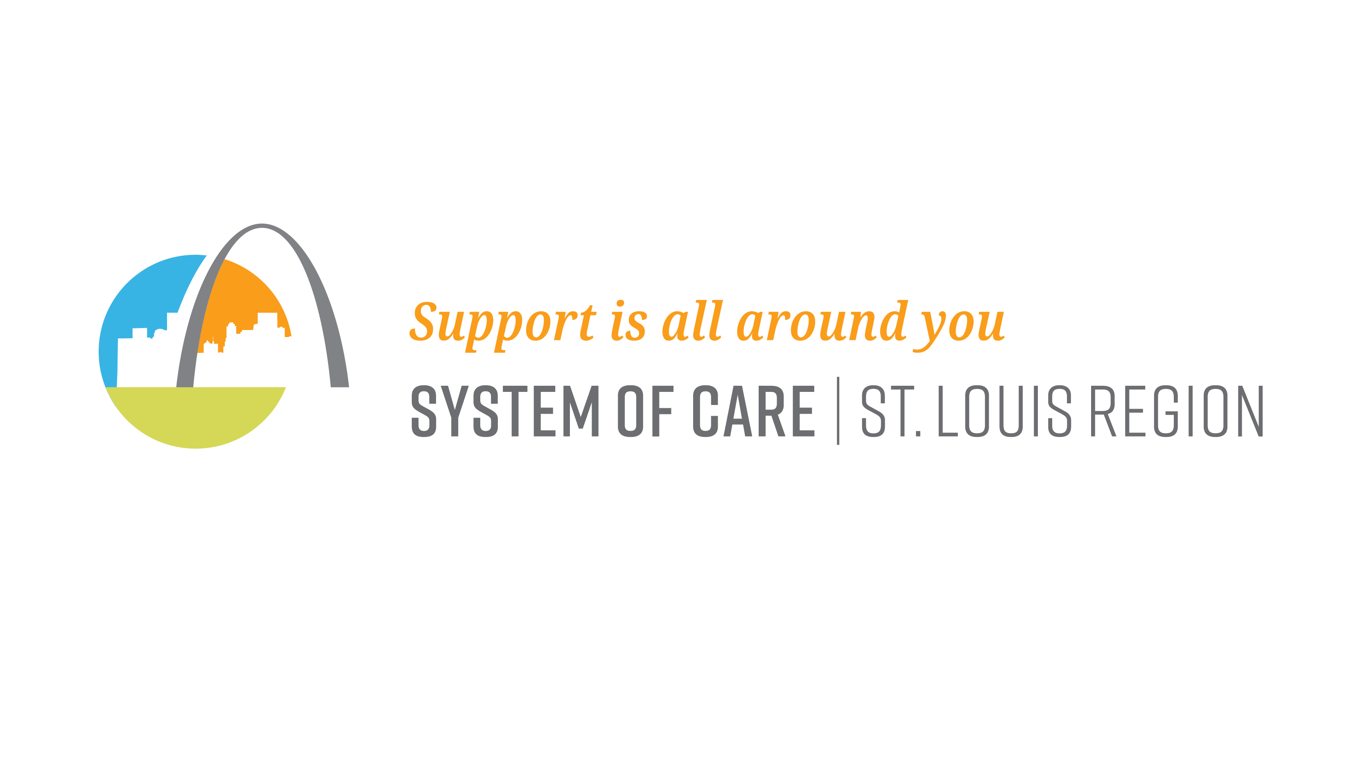
Strategic Initiatives
Role: The System of Care (SOC) is a collaborative network of agencies, families, and youth focused on the total health of children and families with, or at risk for, serious emotional disorders. The SOC supports a family-driven, youth-guided approach to care. Youth of color and LGBTQI youth experience significant disparities in homelessness, therefore MHB’s 3rd SAMHSA Federal Cooperative Agreement will focus on these populations.
Funding: Substance Abuse and Mental Health Services Administration Cooperative Agreement; $997,909 annually for 4 years through September 29, 2027.
Key Partners: Vision for Children at Risk, St. Louis Queer Support Helpline, Behavioral Health Response, Youth In Need, Motivating Purpose with Education and Readiness (MPWER), Keys to Knowledge and Action, Missouri Institute for Mental Health
Notes:
SERENA
The System of Care is a great example of how MHB can leverage external funding. This federal program is designed for units of government to draw down funding through a cooperative agreement. This is a special funding mechanism that dedicates 30% of its budget to infrastructure, which greatly enhances our ability to advance systems change. This is important because our tax funds are primarily used to support program delivery, but without systems change, programs face an uphill battle in achieving population level impact.
READ SLIDE

Slide 23

Strategic Initiatives
Role: To align, convene, communicate, and connect the organizations addressing Gun Violence Prevention and Reduction.
​
Goal: A reduction in gun related crimes, injuries, and deaths throughout the St. Louis Region focusing on high-risk youth.​
St. Louis Area Violence Prevention Commission Funding:
  Missouri Foundation for Health $500,000 over 5 years
  City of St. Louis Department of Health $1,000,000 over 5 years
  Saint Louis MHB $40,000 annually
Notes:
SERENA
You’ll recall that one of our strategic opportunities focused on maximizing all resources. This means not just focusing on the dollars we can invest, but also paying attention to our ability to convene, plan, and mobilize partners. The VPC is a great example of that type of work. This cross-sector partnership works regionally across multiple sectors to prevent and respond to gun violence. MHB serves as the fiscal sponsor and backbone organization for VPC, but the primary funding sources for VPC are external. MHB provides staff support, the coalition of nearly 60 members plays a critical role in
READ SLIDE

Slide 24

Strategic Initiatives
Gun Violence Response Network with Mental Health Access Project
Role: Coordinate the community-level response to nonfatal shootings
Funding: 1-Year Substance Abuse and Mental Health Services Administration Community Project Grant; $600,000 for FFY23 with 12-month no-cost extension
Key Partners: Provident Behavioral Health, Safe Streets Safe Neighborhoods, Conversions Global Marketing, Haven of Light School of Mental Health, Crime Victim Center, InPower Institute, Power4STL, St. Louis Community Health Worker Coalition, United Way 211
Notes:
VPC created the Gun Violence Response Network (GVRN) in 2020 as a step toward the objective of coordinating the community-level response to nonfatal shootings.
It is a network of service providers with multiple entry points, a coordinated intake, and wraparound services for victims of violence.
VPC convened victim service providers through the its Service Delivery Committee to identify unmet needs for victims of nonfatal shootings, to work with United Way 2-1-1 on a first of its kind gun violence intake, and to partner with resource agencies to meet victims' needs. The most unmet needs that the committee members identified were mental healthcare, employment, basic needs (like utility assistance), and funds to fix property damage.
VPC's objective to coordinate services for victims was created in response to the Department of Justice's (DOJ) Diagnostic Analysis for the City of St. Louis from 2017 which recommended that interventions focus on nonfatal shootings to interrupt the escalating cycle of violence. Victims of crime are also more likely than nonvictims to develop Post-Traumatic Stress Disorder.
The GVRN provides a referral method for law enforcement and community partners to connect victims and families to services. The GVRN anticipates serving 600 victims of nonfatal shootings between St. Louis City and St. Louis County and linking them to mental health and other support services during the year of grant funding.

Slide 25
Federal Grants, Fiscal Sponsorships & Other Significant Funding Partnerships
Federal Grants | Backbone Organization | Cooperative Agreement | Fiscal Sponsor | Local Government Fund Distribution | DMH Partnership for Medicaid Match
New SAMHSA SOC 4-YR Cooperative Agreement 9/23 – 9/27 | St. Louis Area Violence Prevention Commission Director is MHB staff member Housed at MHB | City of St. Louis Senior Fund Housed at MHB Provide services of MHB Controller | St. Louis Area Violence Prevention Commission | City Community Development Administration American Rescue Plan Act COVID-19 Federal relief funding for early childhood providers (distributed in FY23) | Adolescent C-STAR program offered by Preferred Family Healthcare (funded annually since 2007)
SAMHSA Community Funded Project VPC Gun Violence Response Network 1-YR Grant 9/22 – 9/23 12-month no-cost extension thru 9/24 |  |  | City of St. Louis Office of Violence Prevention National League of Cities Reimaging Public Safety 2-year grant 9/22 – 9/24
VPC APRA 5-YR Youth Safe Space Grant 11/21 – 12/26

Slide 26
Allocations and
Grant Making

Slide 27
Equitable and Accessible Grantmaking
Applicants really appreciate the technical assistance and availability of staff
“These ladies met me right where I was in the grant seeking process, which was fairly new. They looked past that and saw the passion I had for the work that I do and they helped me channel that into the correct wording in order to apply for this grant. They were simply amazing; never got frustrated. The ladies were very kind in the way they spoke with me and assisted me. They asked questions to provoke me to think and look at my program in different ways, which was truly helpful.”
“The one-on-one support and level of detail/feedback was extremely helpful. All your work to help us was INCREDIBLE! Not every funder does that, so it was greatly appreciated.”
“Staff listened to our thoughts about expanding the programs we were applying for and provided feedback on ways to structure our budget and application.”
Notes:
SERENA
Feedback form our most recently completed CCSF application process this past spring. Emphasize how different our approach is to grantmaking. We don’t just rely on the paper applications. We make ourselves available as a resource so that people have a chance to put their best effort forward.

Slide 28








Funded Partner Experience
Our Commitment to the Funded Partner Experience
Communication – Staff Contact, Prompt Response, Proactive Approach
Grantmaking Process – Timeline and Consideration, Consistency, Performance Management
Relationship – You are an Expert, Sharing Resources, Assume Best Intentions
Notes:
SERENA
MHB actively participates in peer funder cohorts to establish and uphold best practices in grantmaking. In 2021, the funders you see here adopted a set of standards that we call the Funded Partner Experience. It articulates our commitment to addressing the inherent power dynamics in grant making by respecting providers as partners in our mission to serve the community. These principles guide how we communicate, how we design our processes, and the value we place in the expertise of our partners who provide direct services.

Slide 29

Grantees as Partners
Simplified reporting process to reduce administrative burden on grantees
Lead staff are available for troubleshooting throughout grant period
Three-year grant cycle with annual renewals to allow for flexibility in program implementation
Outcome-based funding
Capacity-Building Initiative
Notes:
SERENA
Here are a few examples of what we do to engage service providers as partners.
READ Slide

Slide 30


Person Centered Investment Strategy
“Prevention programs which promote healthy lifestyles among children and youth and strengthen families”
Notes:
SERENA
As we’ve discussed, the Trustees have always centered the purpose of the fund in their investment strategies. This quote is taken directly from the ballot language that was used to pass the original children’s service fund tax. While the statute lists types of programs that can be funded, the ballot language communicates the intent of the fund. The community approved a measure to support prevention programs for children, youth, and their families. This philosophy has guided our decision to support afterschool programming and paved the way for our most recent ballot initiative to establish a dedicated early childhood fund.

Slide 31
Application Renewals
Staff conduct annual site visits
Organizations submit renewal applications each year
  There are no automatic renewals
  Each cycle organizations compete for funding
  Funding that is unspent is returned to MHB at the end of the 3-year grant period
Staff review and approve renewal applications internally
  Trustees vote on a resolution to provide for funding all staff approved renewals
Notes:
SERENA

Slide 32
Community Investment Policies
Demonstrate fiscal, administrative and managerial stability, prudence and diligence
Local, state and federal regulatory compliance
Individuals receiving MH services require documented diagnosis except prevention/early intervention
Provide culturally & linguistically appropriate services
Funds may not be used to provide direct / indirect support of any religious education, service, or otherwise assist a religious mission (content neutral manner)
Notes:
CASSANDRA
Next, we want to share a high-level overview of our Community Investment Policies. All funded organizations:
Must demonstrate stability and responsibility in terms of finance, administration, and management.
Must follow all local, state and federal requirements.
For individuals receiving clinical MH services a documented diagnosis is required BUT this does not apply to those receiving prevention or early intervention services
Culturally & linguistically appropriate services must be provided
All services must be provided in a content neutral manner and cannot be used to support of any religious education, service, or mission

Slide 33
Community Investment Policies
MHB funds cannot supplant other revenue sources
Applicants must meet all additional specific eligibility requirements established by specific revenue source (e.g., CMHF)
Maximum $750K for single project/program per FY
Maximum $100K for start-up projects (Year 1)
MO certification or license (e.g., DMH certification, licensed clinicians)
Preferences for accreditation, board member residency in St. Louis City/County, service delivery in City
Link to Community Investment Policies on MHB website
Notes:
CASSANDRA
MHB funds cannot duplicate or replace any other funding received
Specific eligibility requirements for CCSF grants must be met
A maximum request of $750K may be made per program per year
A maximum request of $100K may be made for start-up project in year 1
If your program or service requires MO certification or licensure (e.g., DMH certification, licensed clinicians) MHB requires verification of these credentials
And as a final note, it is preferred that funded organizations are accredited (when possible), board members reside in St. Louis City or County and service delivery occur in the City

Slide 34
MHB Disclaimers
MHB reserves the right to amend, modify or cancel the competitive funding application process in whole or in part if it is deemed to be in the best interest of MHB to do so.
MHB reserves the right to reject any and all applications, to waive formalities, and to select the applications which are, at MHB’s sole discretion and allowed by statute or regulation, in the best interest of MHB.
MHB reserves the right to reject applications that are inconsistent with Missouri statutes and regulations, St. Louis City ordinances or MHB policies and priorities.
MHB reserves the right to negotiate specific terms of an application if it is deemed to be in the best interest of MHB to do so.
MHB reserves the right to require supplemental information or documentation from applicants to clarify and/or verify information provided in the application.
The competitive funding application process does not obligate MHB to select an applicant, pay the costs incurred in preparation of any responses hereto, or to procure or contract for the services or outcomes described herein.
MHB may exercise the foregoing rights at any time without notice and without liability to any applicant or any other party for expenses incurred in the preparation of responses hereto or otherwise. Responses hereto will be prepared at the sole cost and expense of the applicant.
Notes:
CASSANDRA
Trustees make final decisions.
Explain limitations of sunshine law and open records with decision making in public meetings
Now we are going to shift gears from understanding the application requirements to what we are calling ”the fine print” to ensure we are being as transparent as possible and seeking to explain the funding requirements as clearly as we can. Ultimately, MHB makes the best choices it can with the information available, but also like any written document it’s not possible to anticipate every possibility. This may mean that adjustments need to be made along the way and in all cases, we will be transparent whenever we need to course correct.
Our disclaimers listed here outline MHB’s legal authority to make changes as needed to achieve the best outcomes possible for the community. In plain language this statement indicates that:
* The competitive funding application process can be amended, modified or cancelled at anytime
* Any and all applications can be rejected, formalities waived, and then applications selected at MHB’s sole discretion in the best interest of MHB as allowed by state statute or regulation
* Applications that are inconsistent with Missouri statutes and regulations, St. Louis City ordinances, or MHB policies and priorities can be rejected
* Specific terms of an application can be negotiated
* Supplemental information or documentation from applicants to clarify and/or verify information provided in the application may be required
* The competitive funding application process does not mean MHB must select an applicant or pay any expenses associated with application preparation
* And finally any of the above can happen at any time without notice, without liability, and MHB is not responsible for any associated expenses

Slide 35
MHB Community Investment Approach to be discussed at January 27 Board Retreat
Strategy | Purpose | Outcomes | Mechanism
Core Funding for Essential Services | Sustain and improve critical infrastructure for equitable service delivery | Support the most serious disorders – Provide trauma-informed care at an increased level of intensity, consistency, and stability Help the most affected populations – Address barriers to make care more accessible for those most impacted | Longer-term investments for high performing organizations providing essential services 3 – 5-year grant cycle with mid-term continuation application 1 application for CCSF & CMHF funds Prioritize integrated family services Separate regional braided fund with STLCSF Explore leveraging Medicaid for specialized services
Flexible Funding for High Quality Prevention Services | Increase the availability of high-quality prevention programs | Focus on young people – Intervene early to prevent or lesson the severity of mental health or substance use disorders | Shorter investments from 1 – 3 years designed to help organizations launch or expand evidence-based programs Early Childhood Facility Improvement Fund Out-of-School-Time Initiative Unallocated Fund
Flexible Funding for High Quality Services Across the Lifespan | Increase the availability of high-quality programs for youth and adults | Expand access to the full range of what works – Increase availability of effective evidence-based care in clinical settings and evidence-based/ promising practices in non-clinical settings | Shorter investments designed to help organizations launch or expand evidence-based programs Traditional 3-year competitive cycle Funding for programs and services that address MHB funding priorities Focus on projects that remove barriers to service delivery and increase access Emerging Needs Fund – staff directed open timeline; responsive fund to address unanticipated needs in the community, with priority given to projects that align with MHB funding priorities
Community Building | Support community-driven programs and initiatives that can effectively reach underserved populations | Transform the landscape – Fund innovation and higher risk efforts to create transformative change | Smaller grants paired with dedicated technical assistance 2-year grant cycle with 2-cycle limit Community-driven needs assessment to set funding priorities Grants under $100K Categories: Piloting/launching an innovative concept, Expanding or enhancing an existing program, Maintaining a successful program

Slide 36
Potential Implementation Timeline for Changes to MHB’s Community Investment Approach
Community Investment Strategies Potential Implementation Timeline | FY23 | FY24 | FY25 | FY26 | FY27
Core Funding for Essential Services Grants Awarded
Flexible Funding for High Quality Prevention Services – CCSF FY25 One-Year Extension
Flexible Funding for High Quality Prevention Services – Early Childhood Facility Fund Grants Awarded
Flexible Funding for High Quality Prevention Services – Out-of-School Time Initiative Grants Awarded
Flexible Funding for High Quality Services Across the Lifespan - Emerging Needs/Unspent CCSF Allocation
Community Building Grants Awarded

Slide 37
MHB Staff Organizational Chart

Slide 38
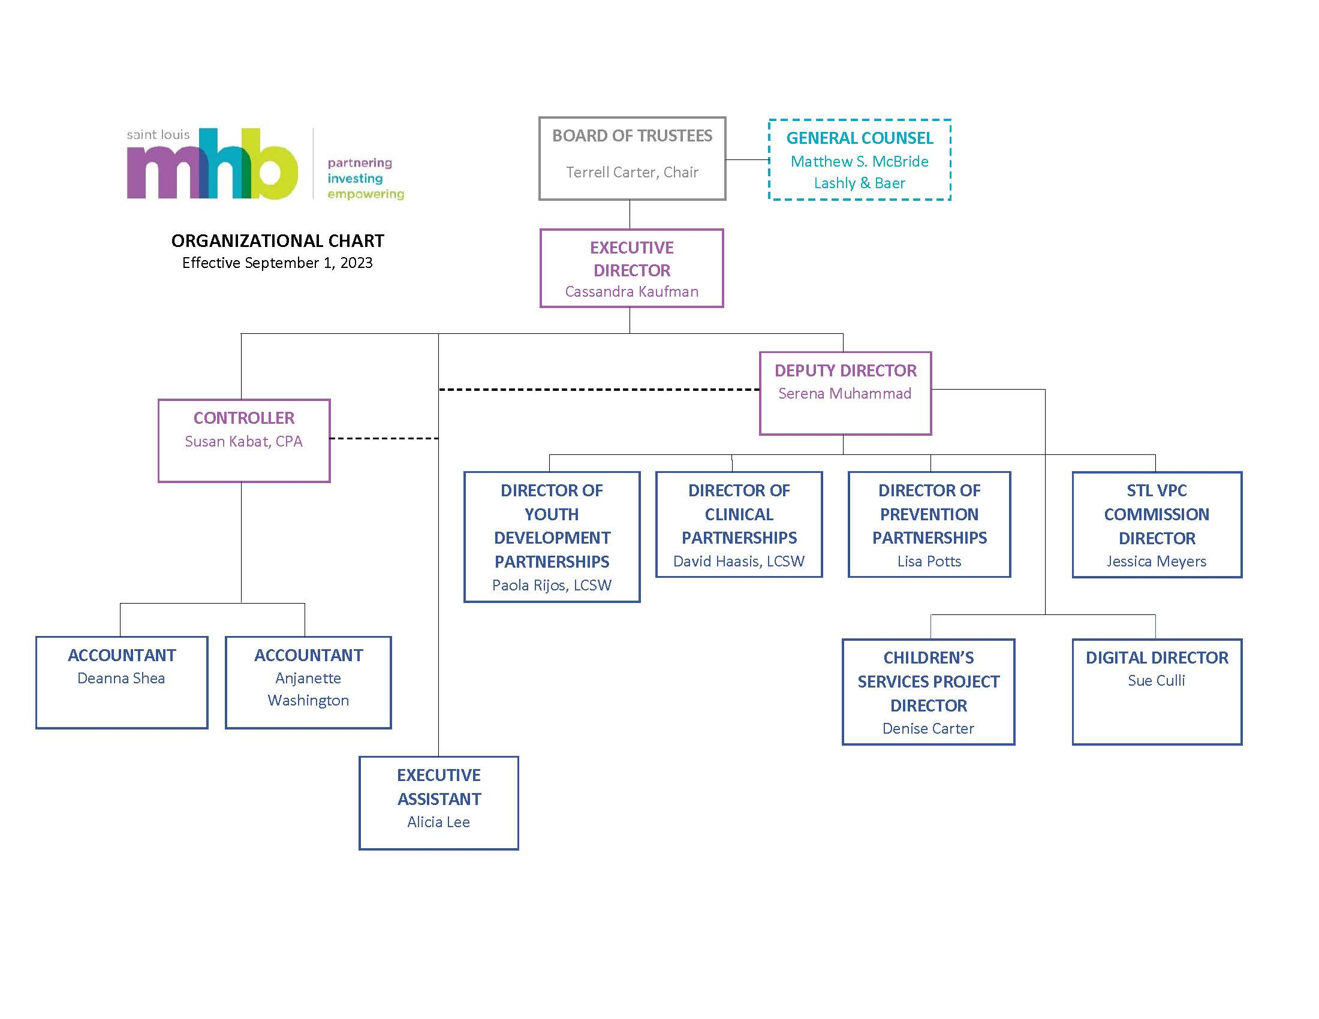
Saint Louis MHB Staff
Notes:
CASSANDRA

