Slide 1
Out of School Time
Investment Approaches
Research Conducted by Coro Fellow
Alford Young III
November 20, 2025

Slide 2
OST Program Advantages
The capacity to center mental health literacy without having to factor in mandatory school-time curriculum requirements.
Expand young people’s mental health knowledge, coping skills, and knowledge regarding mental health resources accessible to them.
Create family-instructor connections that can promote early identification of emotional, behavioral, and/or mental health challenges while also expanding familial knowledge regarding available mental health resources.
Build protective, trust-based adult–youth relationships that strengthen resilience in helping to mitigate the physiological and psychological impacts of Adverse Childhood Experiences (ACEs).

Slide 3
High Quality Programs
Criteria | Why it Matters | Intended Impact
Literacy Component | Improving literacy strengthens self-efficacy, enhances problem-solving skills, and fosters empathy and perspective-taking – outcomes that promote resilience, facilitate social growth, and bolster psychological well-being. | Improved literacy rates (lower association with worsened or onset of mental health issues) Enhanced self-efficacy and academic motivation Reduction in long-term dropout risk
SEL / Mental Health Educational Component | Intentional time to develop stress-management skills, learn healthy relationship practices, and improve upon emotional regulation – all of which support their psychological well-being. | Strengthened emotional regulation and self-awareness Improved peer relationships and social functioning Earlier identification of youth who may need additional support

Slide 4
High Quality Programs
Criteria | Why it Matters | Intended Impact
Multipurpose Programs | Varied experiences help sustain youth participation, reduce disengagement, and promote intellectual development in ways that strengthen self-esteem and overall mental well-being. | Increased youth participation and attendance Reduced chronic absenteeism Engagement from youth with a range of interests
Administered by an Organization with Established Community Trust | Deeper relationships with families and youth, and a more nuanced understanding of local needs | Increased family engagement and trust More accurate and consistent identification of youth needs Strengthened sense of belonging and emotional safety for youth
Pipeline to Hiring (for participants) | Programs that integrate workforce preparation, skill development, and pathways to employment provide older youth with a sense of purpose, future orientation, and self-efficacy – all of which promote psychological well-being. | Clearer post-secondary education pathways that support long-term psychological well-being Reduced youth (and future adult) unemployment

Slide 5
RFP Approach
Benefits
Constraints
Flexibility and innovation. Allows diverse and specialty local providers to propose creative programming that responds to neighborhood-specific needs.
Direct embedding of quality requirements. MHB can specify SEL integration, literacy supports, parent engagement, and sustainability criteria directly in the RFP.
Prioritization of unmet demand. Enables immediate expansion for organizations with waitlists or capped enrollment.
Geographic rebalancing. Can prioritize applicants serving neighborhoods with high ACE exposure and limited access to OST programs.
Risk of fragmentation. May generate a disconnected set of programs with uneven quality or alignment.
Short-term program stability concerns. Smaller or newer organizations might lack the capacity to sustain programming across the full grant cycle and face significant challenges continuing operations once funding concludes.
Inconsistent mental-health alignment. Without strong guardrails, some programs may emphasize enrichment over SEL and mental-health supports.
Capacity bias. Prominent, well-resourced organizations may be advantaged over community-trusted but under-resourced ones.

Slide 6
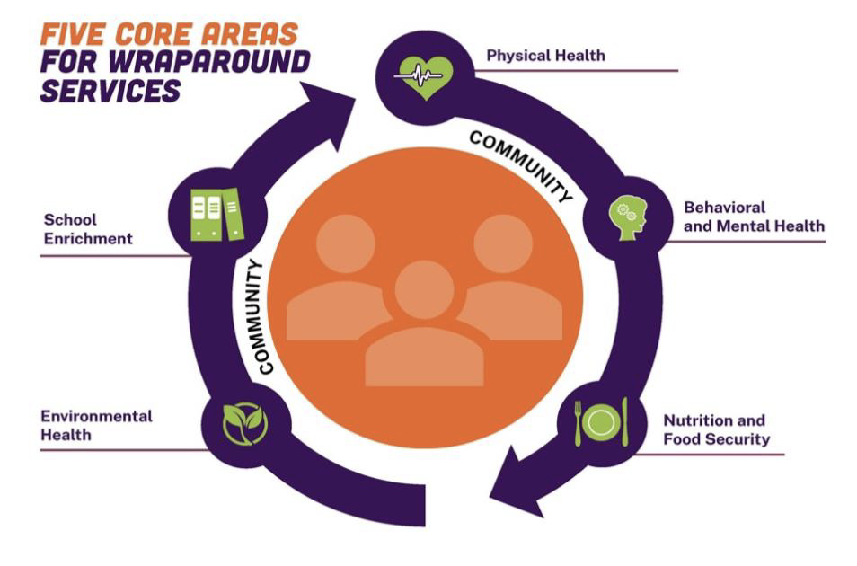
Systems Level Approach
Facilitate or Enhance an existing multi-organizational partnership
Data partner
Family liaison

Slide 7
Systems/Partnership Approach
Benefits
Constraints
Coherent, shared quality standards. Establishes consistent, MHB-derived expectations for partners engaged in the effort.
Built-in mental-health infrastructure. Allows mental-health literacy, parent engagement strategies, and resource navigation to be integrated across the system.
Reduced burden on providers. Shared staffing, centralized training, and collective data systems ease pressure on organizations already stretched thin.
Stable and potentially multi-year effort. Supports consistent routines and relationships that promote emotional regulation, resilience, and well-being.
Limited access for emerging providers. Niche organizations may not fit into the established partnership framework.
Risk of over-standardization. Uniform requirements may reduce flexibility and limit culturally specific or community-tailored programming.
High coordination demands. Requires significant upfront staffing and governance to ensure sustained collaboration.
Vulnerability to partner instability. Past collaborations faltered when funders withdrew. Similar risks persist without long-term commitments.
Slower to scale. Systems-building can delay the immediate expansion of OST access in high-need neighborhoods.

Slide 8
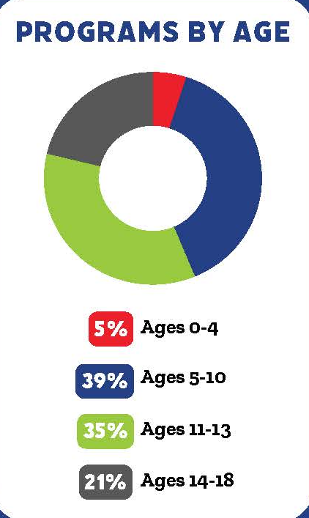
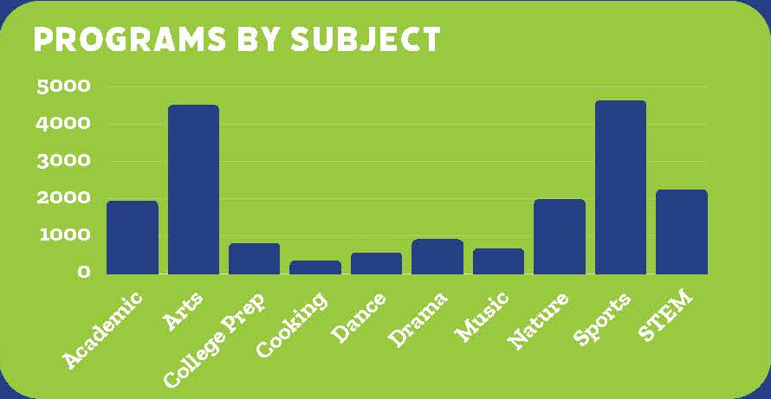
Summer Program Availability
OST Summer program availability by subject and age in the greater St. Louis region according to Blueprint4

