Slide 1
STLMHBx BELOVED
KICK OFF MEETING
November 16, 2023
5:45pm CST

Slide 2
AGENDA
Warm Welcome
Scope of the Project
  Overview
  Timeline Adjustment
Next Steps
Questions (Feel free to ask along the way!)

Slide 3

WARM WELCOME
Name, pronouns, role, and
What superpower would you
give to your arch nemesis?

Slide 4
ZOOM TIPS
For intros & share-outs use “Gallery View” to see everyone’s faces!
Be prepared for a cold call.
Unstable Connection?
  Close other windows/applications
Mute self when not speaking.
Chat host privately with issues.
Use chat for questions (send to everyone).
  We will keep track and share resources.
Self-care: Disable video as needed.
Notes:
12:04 - 30 seconds
Ileana

Slide 5
Client
Onboarding
What to Expect
When Working with Beloved Community
Notes:
12:04
Ileana

Slide 6
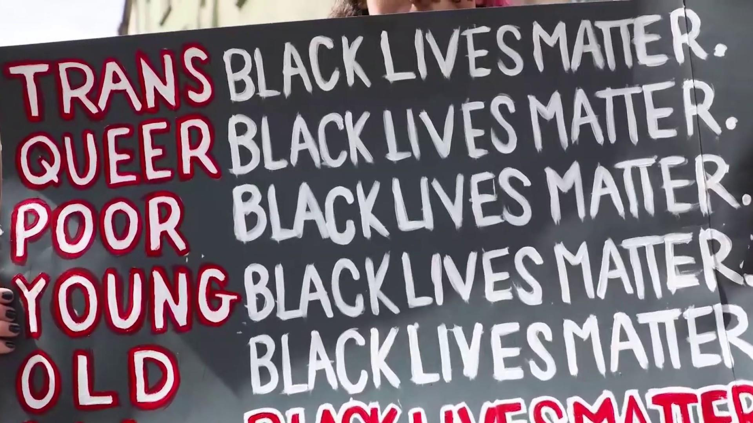

CENTERING BLACK LIVES
Notes:
12:07-12:10
Ileana
We also begin every session with a moment of silence to honor and center Black lives.
Before we begin today, I want to acknowledge that the past two weeks have been heavy with grief and extremely difficult for members of our Black and brown communities. I want us to take a moment and center what happened in Buffalo and also what happened in Texas. My coworker Nicole named earlier today in a meeting that Anti-Blackness is what has been used as a roadmap to inflict harm and perpetually marginalize other communities of color. Once again, we have been reminded of how blatant and “in your face” white supremacy exists and operates in our nation. We have seen the stark contrast between how white and BIPOC members of our society are treated. Black people we see you, we see your hurt and your pain, we see how you so often are forced to hold relief and dread in balance. The history of Black Americans is filled with both joy and pain and both a unique and painful relationship to ideals of freedom and emancipation. When we say black lives matter, we do mean all black life and in all of its intersections.
Today we ask that you breathe in the words of Dr. Martin Luther King, Jr., as he calls for a divine dissatisfaction with the current state of our nation, and commit to how your dissatisfaction will propel you to action today and every day. We ask you to breathe, to show up how you’re able, and to know that we hold you closely in our beloved community.
So we invite you to take a moment here to center the Black members of your schools/organizations/businesses and your beloved communities. We implore you to spend time operationalizing your commitments to DEI that impact the lived experiences of your Black staff and young people that are trying not just to exist but also to thrive in spite of the weight of oppression and injustice.

Slide 7
INDIGENOUS LAND
ACKNOWLEDGEMENT
Bulbancha, where we are based, was founded upon an Indigenous place known as “Bulbancha,” which means “the place of other languages” in the Choctaw language. This has been a place of trade, inhabitation, and cultural interaction for Indigenous Nations for several centuries. We also want to name that this has been a place in which Indigenous and African Peoples have been trafficked, enslaved, and discriminated against. We honor those who have fought for justice here and have fought against the process of colonization of these lands, and strive to play our part in continuing that fight.
Many Indigenous Nations dwelled in and regularly visited Bulbancha, including, but not limited to, the Houma, Biloxi, Chitimacha, Choctaw, Tunica (TOON-ica), Atakapa-Ishak (Ah-Tah-KUH-Paw ee-SHAK), Natchez, Washa, and Chawasha. Indigenous Peoples still live in this area and Indigenous Nations have made a lasting contribution to area culture. We honor with gratitude the land itself and the people of these Indigenous communities.
Notes:
12:10-12:13
Ileana
We always open every session with an indigenous land acknowledgement.
New Orleans, where we are based, was founded upon an Indigenous place known as “Bulbancha,” which means “the place of other languages” in the Choctaw language. This has been a place of trade, inhabitation, and cultural interaction for Indigenous Nations for several centuries. We also want to name that this has been a place in which Indigenous and African Peoples have been trafficked, enslaved, and discriminated against. We honor those who have fought for justice here and have fought against the process of colonization of these lands, and strive to play our part in continuing that fight.
When we worked with an indigenous consultant to help us with our ILA, they also gave us additional guidance, and they told us to implore other cities to do their own research on the indigenous communities in their place (Memphis). We aren’t doing a Memphis ILA because its not where we are based but we encourage you to do their own research

Slide 8
OUR PHILOSOPHY
Notes:
12:14 (10 seconds)
Nicole

Slide 9



HEAD & HEART APPROACH
Finance
Engaging Head & Heart
Culture
Operations
Governance
Programs
Notes:
12:14-12:16
Nicole
We take a head and heart approach to diversity, equity, and inclusion. Some of us are head-focused -- we want to dive into data, look at outcomes, pour through graphs and spreadsheets and action plans.
Some of us are heart-focused -- we want to bake in reflection and meditation, we’re often found discussing why these topics are important to us personally and to our work, and encourage others to do the same. Where are our “heart” people? Who feels like they fit squarely in both head and heart?
Our capacity-building model, both today and in longer-term engagements, relies on both head and heart. Too often we think that diversity, equity, and inclusion is a people-facing strategy and we send the “heart” people off to lead that work. But we know that equity is about investments -- governance, finance, operations, etc. Equity requires that we examine policies around pay equity, supplier diversity, staffing assignments, budget allocations, in addition to typical culture data like climate surveys, participant satisfaction, and program demographics.

Slide 10

PEOPLE.
CHANGE.
SYSTEMS.
People are the greatest unit of change. When people embrace shared values, they are more likely to champion systems for positive change.
Everyone has an obligation to make personally relevant change. When our leaders change, they also accelerate structural change for the organizations they lead.
The default systems in our country are designed to segregate. When we question and challenge the default, we can dismantle it and build equitable systems in its place.
Notes:
Nikki just review the slide and not the scripting
What We Believe
We believe that people change systems. The Beloved Community facilitation philosophy can be described as a people-centered approach. We aim to center and honor the experiences of our participants and ourselves as facilitators. All of our sessions include individual work about who we are as people, meaning making as a group, and pre and post-work. We are not lecturers and we are not the “face” of an organization’s DEI work. We know that issues of diversity, equity, and inclusion have deep, complicated ways of evolving and showing up in organizations so we support our participants in their meaning-making of said issues and topics, and empower them with tools and strategies to lead this work in their organizations.
We interrogate neutrality. What this looks like is that we challenge the notion of neutrality and will always ask ourselves and others to look at the issues they are experiencing from a multifaceted approach, taking into account how their identities may be coloring how they view or perceive issues in their organization. We ask,”Who do your policies and practices benefit and who do your policies and practices marginalize?”
We center Blackness and the experiences of BIPOC. We challenge white supremacy by centering the experiences of Black, Indigenous and People of Color communities in our facilitations by naming how whiteness and anti-blackness shows up in organizations and individuals. We are clear that anti-blackness is a tool of white supremacy designed to keep whiteness in power. Centering racial equity in our examples is a throughline in our work.
We center Intersectionality. We honor the multiple layers of overlapping oppression that is experienced by communities who have multiple, marginalized identities. We select intersectional examples to present in our facilitations and content delivery to clients. This might sound like incorporating gender identity and race into sessions, even if the explicit session topic is about race.

Slide 11



OUR THEORY OF CHANGE
Regions demonstrate economic growth and
equitable access for all.
Equity as Economic Development
We create the national coalition for diverse workforce to leverage the business case and internal corporate practices for the workforce
of the future.
Policy Advocacy for Diverse
Schools, Diverse Housing
We advocate for local & regional policy shifts that create more equitable conditions in schools, workforce, and housing.
Capacity-Building for Workforce
of the Future
We build and lead regional coalitions (housing agencies, corporations, schools, non-profits, small businesses) and provide direct services to deepen their capacity to serve diverse populations, develop diverse talent pipelines, and support diverse leadership.
Notes:
Our theory of change is that to get to regions demonstrating economic growth and equitable access for all, equity must be at the heart of economic development and considered a workforce skill. Under these tenets we build the workforce of the future. We advocate for policy that sustains diverse schools and diverse housing, and a large part of our work is around capacity building - to ensure that the people in institutions are able to serve diverse populations, develop diverse talent pipelines and support diverse leadership. The framework for our capacity building piece with schools is what we will be introducing today.
Nikki- POint to them being in STL which is in our region

Slide 12

MUTUAL ACCOUNTABILITY
FRAMEWORK
This is how we start to weave this work together.
PROCESS METRICS
How can we observe and identify shifts in our behavior?
INTERNAL EQUITY AUDITS
Leadership, Staff, Board, Students,
& Parents.
OBSERVE AND IDENTIFY OUR BEHAVIOR
LEADERSHIP, STAFF, BOARD, COMMUNITY
ABSOLUTE
PERFORMANCE
PERFORMANCE METRICS
Absolute Outcomes.
Notes:
The mutual accountability framework is one way that we start to weave this work together. If any of you are elementary specialists, you’re familiar with the unit Who am I? Who are we? Who are we together? That’s how this framework is designed. The yellow band, the orange band, the red band.
And one way that we keep the head issue prominent for orgs is by developing Mutual Accountability Frameworks that monitor progress against DEI strategies, internal equity audits, and personal leadership development.
We’ve build a Mutual Accountability Framework that organizations institutionalize that helps them to sustain equity commitments in their organization.
This framework leads through the process of personal change to institutional change and is structured around our DEISI
Yellow - personally observing your own change against the equity lens map - a tool we’ve developed for individuals to assess where they are - from Active Resistance to Passive and Active Compliance to Championship, and what they can do to help them progress along the continuum.
Orange - Internal Equity Audits built around the DEI- by stakeholder group - each assesses their own performance - looking at the data - this helps us to look how are we as a group doing. Everyone understands their piece to which to hold themselves accountable
Red - Absolute performance metrics: performance - school achievement; reducing suspensions, increasing staff and family satisfaction, etc.
Now that you know about us, Manny is going to talk about our Cohort Model
(Nikki)Basis: Keeps each level from pointing the fingers and they are instead of working together for equity and accountability. They will really start to feel the mutual accountability because we are doing the orgwide and individual asessment

Slide 13
TEAM

Slide 14




BELOVED TEAM SUPPORTING THIS WORK
Lauren Young
Director,
Data & Analysis
she, her, hers
Cassandra Solis
Associate Director, Equity Tools & Programming
she, her, hers
Nikki Williams Rucker
Associate Director,
Equity in Schools
she, her, hers

Slide 15
PROJECT COMPONENTS

Slide 16
Equity Audit & Equity Lens Map Overview
Equity Audit
Beloved Community’s Equity Audit is an online tool that aids organizations (both K-12 and universities), in assessing their institutional practices. This tool explores hundreds of indicators that assess the current state of an organization or institution’s stakeholders, community partners, board members, employment, hiring practices and more
Equity Lens Map
The Equity Lens Map is an individual assessment that is intended to illuminate for organizational leaders the differentiated learning experiences necessary for individuals within the organization to advance equity in the workplace.
Notes:
ELM measures equity leadership competencies for every employee so that, in addition to implementing comprehensive organizational equity plans, organizations can consistently develop equity leadership competencies in all of their team members.

Slide 17
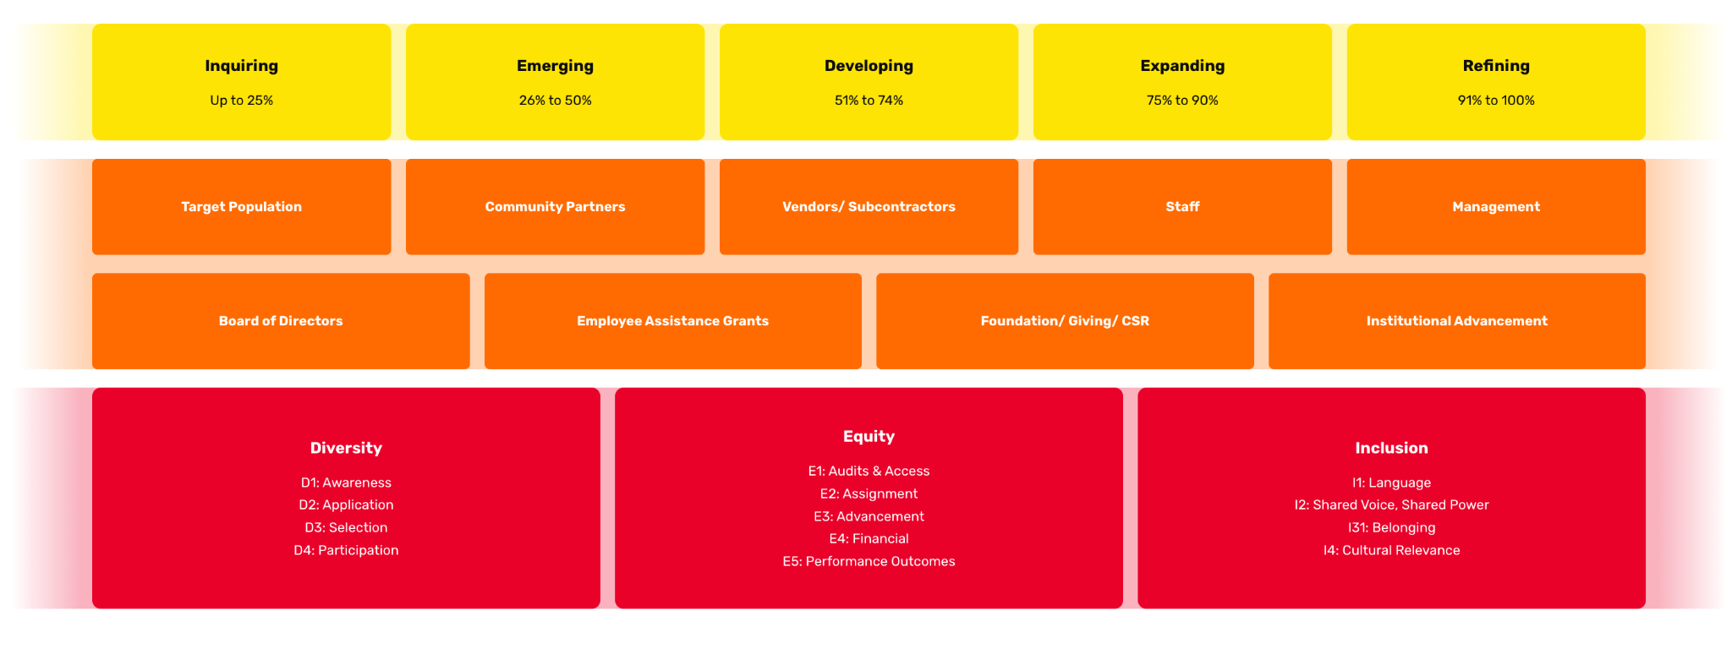
EQUITY AUDIT FOUNDATION
Notes:
CASSANDRA (11:30-11:32 CST)
We’ll take a few minutes here to center ourselves in the structure of the tool….
The Equity Audit is built upon the foundation displayed here. At the very bottom, you have the Beloved Community Standards & Substandards. From left to right we see Diversity, Equity, and Inclusion, along with the 13 discrete substandards within those.
The tool is built upon these standards and they are woven into every indicator (or question) in each shared interest partner/function section that you see in the second row here - Students, Parents/Guardians, Community Partners, Faculty/Staff, Admin, Board of Directors, Vendors/Subcontractors, Employee Assistance Grants, Scholarships, and Institutional Advancement.
Every question or indicator in the tool can produce a score of 1, 2, 3, or 4. The scores for every question roll up into a total score for each shared interest partner function section, and each standard and substandard. The points are then turned into a percentage score and each of the scored domains then falls into one of the five score bands displayed here in the top row.
Inquiring is essentially a score of 25% - your organization would have self-rated every indicator question in a specific domain with the lowest-point value response.
Then we have Emerging, which is up to 50%, Developing which is up to 74%, Expanding, which is up to 90%, and Refining, which is for scores between 91 + 100%.

Slide 18
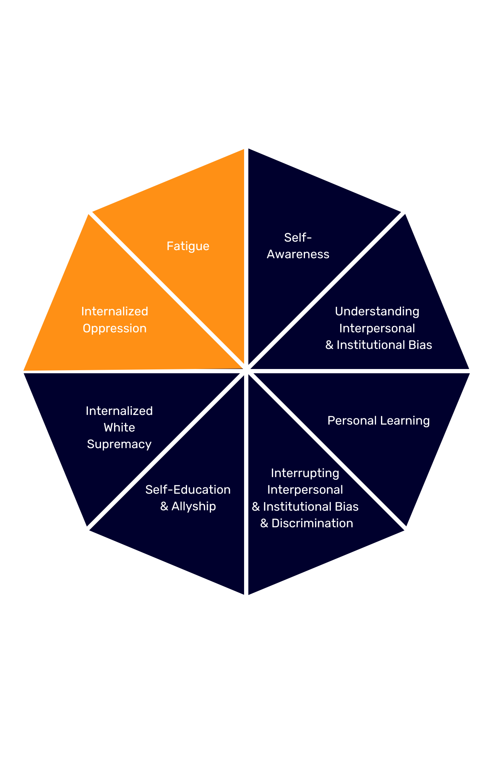
EQUITY LENS MAP DOMAINS
High
Mid
Developing
Developing
Notes:
All respondents are presented with questions in the sections displayed here in red. Individuals who, at the beginning of the self-assessment, identify as Women, LGBTQIA+, and/or BIPOC, also respond to the two additional sections displayed in orange.
The Equity Lens Map is intended to illuminate for organizational leaders the differentiated learning experiences necessary for individuals within the organization to advance equity in the workplace.
ELM measures equity leadership competencies for every employee so that, in addition to implementing comprehensive organizational equity plans, organizations can consistently develop equity leadership competencies in all of their team members.
All respondents within an organization will respond to a series of statements in six domains:
Self-Awareness: Respondents consider awareness of their social identities and bias in their personal and professional lives.
Understanding Interpersonal & Institutional Bias: Respondents reflect on their understanding of interpersonal and institutional bias in the workplace.
Interrupting Interpersonal & Institutional Bias & Discrimination: Respondents reflect on their capacity to interrupt bias and discrimination as it occurs in the workplace.
Self Education & Allyship: Respondents reflect on their understanding and experience with thoughts and behaviors associated with allyship. Most simply, being an ally can be defined as supporting a person or people with an identity marker that one does not share.
Internalized White Supremacy: Respondents reflect on a series of statements that refer to social structures and norms established by a white-dominant society. Internalized White Supremacy refers to the effects of these structures and norms on an individual's bias towards BIPOC and the beliefs and actions that sustain the structures of racism.
Personal Learning: Respondents reflect on their engagement & personal development to interrogating their own privilege and oppressions attached to one's social identities.
Staff who self-identify within the Equity Lens Map as BIPOC, women, and LGBTQ will respond to a series of statements within two additional domains:
Internalized Oppression: Respondents reflect on a series of statements that refer to beliefs we hold about our own marginalized identities.
Fatigue: Respondents reflect on a series of statements that refer to fatigue. Many members of marginalized identities experience fatigue as a result of feeling the responsibility of advocating, often alone, on behalf of their identity group.
It is important to keep in mind that the results reflect an individual’s personal capacity in this moment, in this organization, in this role, with these circumstances. The Equity Lens Map is not a diagnosis of an individual or an indictment of an organization’s culture.
Imagine if employers were able to offer differentiated training that met each employee where they were on their equity journey? What if your company’s leaders and managers had disaggregated data to inform how they design site-specific professional supports? What if employees could get clear annual guidance on the equity competencies in their performance review? With ELM results, your teams can get the data and support to do all of these.
Develop organization-wide professional development priorities for leadership trainings and workshops
Support middle managers (campus, program, department, region) to drill down on specific DEI needs that reinforce with their teams
Embed equity-related skills into performance management feedback:
Update skills-based performance rubrics with equity-related skills
Establish individual performance goals for equity leadership
Increase accountability for managers to lead with equity
Build an individual learning journey that grows one’s capacity for DEI commitment in the workplace, but in their life
Reduce EEOC and discrimination complaints by increasing accountability for all employees to lead with equity

Slide 19
TIMELINE & SCOPE:
Activity | Month for Completion
Kick Off session | October 19th
Equity Audit & Equity Lens Map Prep Session (W/EA Group) | November
4 hour Thought Partnership Sessions | November/December
EA & ELM Debrief | Schedule in Awa
Notes:
Clients need to give me an agenda 48 hours ahead of time for our meetings
Book thought partnership meetings with clients in the same call (once every 2 weeks)
Does this look right to you?
Let’s schedule the EA/ELM prep call. Do you want to start thought partnership meetings now or wait until after the EA/ELM is completed? Our recommendations are to wait until after
GENERAL LANGUAGE ON THOUGHT PARTNERSHIPS:
As you begin to put your plan into action, we will support you through the strategic
shifts, change management and communication necessary to operationalize your
equity commitments. Whether we are supporting you in identifying potential
training and capacity building, further diving into specific areas of the audit results,
reviewing new policy proposals or identifying relevant strategies for your
organization’s highest priorities, Beloved Community will serve as a trusted partner
on your implementation journey. Oftentimes the volume of data from the audit can
be overwhelming. These supports will help leaders to focus their energy, harness
the momentum and lay the path for an ongoing equity journey.

Slide 20
TIMELINE & SCOPE:
PART 3-EQUITY POLICY REVIEW
Meeting to identify which policies need review
Detailed Review: trends, gaps, misalignment
Insights Report: produced with unique information + by triangulating data from the equity tools and focus groups
Activity | Month for Completion
Initial Meeting | June
Equity Policy Review | July & August
Insights report Delivered & Chancellor Presentation | September
Notes:
Detailed review of identified key data, policies, materials and metrics.
A written detailed report and summary presentation detailing insights and recommendations report capturing themes and strategic shifts across all assessment activities. Presented to the Chancellor and Chef of Staff team in July 2022 initial findings and subsequently to the entire Office Leader Team a final version in September 2022.

Slide 21
NEXT
STEPS

Slide 22
NEXT STEPS
NWR send office hour dates for thought partnership sessions
Schedule EA & ELM Prep with EA group.

Slide 23
QUESTIONS?

