Slide 1
Strategic Plan Update
August 18, 2022

Slide 2
Strategic Planning Process Timeline
January 2021 Board Approves 2021-2023 Strategic Plan
4 Strategic Opportunities
Milestones Refined
November 2021 Board Approves Theory of Change
CCSF FY23-25 Funding Priorities
Strategic Approach Refined
Notes:
Timeline – Our strategic plan was developed on a calendar year January 2021 – December 2023, while all of our organizational timelines are set to our fiscal year. One item for us to consider is extending our strategic plan by 6 months to sync up to our fiscal year. This added time would help offset some of the delays we experienced due to staff transitions at the leadership level.
As an organization we have done a commendable job following through with our strategic plan. The board approved strategy has guided our work for the past year and a half and continues to serve as a north star in our day to day operations and decision making. We achieved a significant milestone early on when our planned called for the creation of a Roadmap for Change and in less than a year we created and adopted a new Theory of Change. The Theory of Change then set the foundation for our CCSF FY23-25 application cycle. Now we are using what we learned from that process to make further improvements and refine our strategy which will be reflected in our CMHF cycle.
While this presentation will focus on our programmatic changes, there were several key operations milestones achieved during the strategic plan period. For example, we were able to reduce our operating costs by rebidding our health insurance, update our personnel policies, make a transition to paid time off, and align our organizational table with our strategic approach.

Slide 3
Strategic Plan Milestones Achieved
January 2021 – July 2022

Slide 4

Strategic Opportunities
Promote and implement equitable, high impact service systems and practices
Champion Community Knowledge and Field Building
Maximize All Resources for Greatest Impact
Tailor Communications & Messaging for Meaningful Impact
Notes:
Roughly ½ way through the plan- we’ve made progress on all 4 strategic priorities. I will give a very brief overview of what has been accomplished under each milestone. I will start with Strategic Opportunities 1, 2, and 4. I will cover Strategic Opportunity 3 with our Theory of Change to highlight the overlap there.
As you are listening to the presentation, feel free to make comments in the chat about other ways the Trustees would like to receive information about strategic plan implementation

Slide 5





Progress At A Glance ~ 80% Active
STATUS | OF 14 MILESTONES
 | Complete | 3 of 14 (22%)
 | In Progress | 8 of 14 (57%)
 | Not Started | 1 of 14 (7%)
 | Abandoned | 1 of 14 (7%)
 | Undetermined | 1 of 14 (7%)
Notes:
We are actively working on about 80% of our plan. The other 20% of our plan, indicated here as not started, abandoned, or undetermined requires further input from our Board of Trustees. I will ask questions for you to respond in the chat when I get to them.

Slide 6
1. Promote and implement equitable, high impact service systems and practices
MILESTONES -
Complete a Roadmap to Community Change to guide investments focused on critical need
Develop early childhood program allocation process for new CCSF funds
Synchronize the children and adult allocation funds to allow for comprehensive approaches and reduce unnecessary barriers
Adopt an equity framework and best practice service models based on selected priorities
Notes:
Roadmap to Community Change is our Theory of Change which was adopted by the Trustees November 2021
CCSF process included new EC program
Trustees decided not to fully advance this strategy. Instead we accepted intergenerational applications through the competitive round. This was not exactly a new process, since we already did this through our initiatives. In the past we would determine when an applicant could access CMHF funding based on their program design. This year, however, we allowed organizations to propose multi-family systems approaches. This was a new opportunity that based on the feedback we received from applicants, was not as clear as we would have liked it to be. Ultimately we ended up with 4 intergenerational projects in this cycle. Staff recommends that we revisit the original concept of combining the CCSF & CMHF proposals into one process to achieve our desired result of streamlining service delivery and improving outcomes for children and families. Later this year, we will present an option to adjust the upcoming CMHF cycle to 2 years instead of 3, so that we can sync up the cycles to launch one application process in FY24. We believe that concentrating the application cycle in one year, would significantly reduce the administrative burden on grantees and staff and free up more time for us to focus on other important elements of our strategic plan and Theory of Change.
Question in the Chat: We believe that we can build our organizational capacity by recruiting a full 15 member board, improving our grant review process, and offering more technical assistance to applicants to successfully conduct one allocation cycle. Based on your experience with the CCSF application cycle, what other concerns do you have with a combined cycle and what should we keep in mind as we think about this option?
Blue Arrow means in progress – Two MHB team members have begun drafting an equity framework that we used as a starting point when designing our CCSF Fy23-25. The staff work has paused as we bring on new team members and reassign roles. In the meantime, trustees and staff are participating in FTF Racial Equity Cohort

Slide 7
2. Champion Community Knowledge and Field Building
MILESTONES -
Develop and implement a strategy for integrating community and family voice along with professional input
Develop a list of community, state, and national initiatives and select those from which MHB should learn or participate in and MHB's role in each
Notes:
SLPS partnership to collect parent feedback in early stages of development
Identifying initiatives not yet underway, however this field building activity will be an important precursor to other elements of our strategic plan that focus on leveraging external funds

Slide 8
4. Tailor Communications & Messaging for Meaningful Impact
MILESTONES -
Establish framework and methods for shared decision-making including staff, trustees, and community representatives
Implement both external and internal communications plans
Make improvements to grantee review and engagement processes based on assessments and grantee feedback
Notes:
Joint Review Teams were used for CCSF FY23-25 grant cycle, but we plan to make enhancements for FY24-26 Grant cycle including enhancing recruitment and training of reviewers and expanding grant review training for trustees, more details to come on process improvements in a future meeting
We began to make some improvements to our internal and external communications tools including more fully utilizing Microsoft Teams for internal communication and Hubspot for external communications. At our September board meeting, we will demonstrate a board portal designed to enhance our information sharing even more. We are building organizational infrastructure by deploying new communication technolody, but we have not yet codified our changes or direction into a communications plan
Again more details to come on changes to grant review, but we are also launching issue based cohorts for CCSF Fy23-25 to facilitate peer learning and we are exploring a funder partnership with three local funders who provide technical assistance to their grantees for organizational capacity building through a resource called Catch A Fire

Slide 9
MHB’s Theory of Change
Intersection with Strategic Opportunity Three

Slide 10

Saint Louis MHB’s Theory of Change
COMMUNITY CONTEXT—Since 2008, the City of St. Louis’ population has experienced improvements in factors of economic and community well-being (such as median household incomes, unemployment, violent crime, and most behavioral health emergency room visits). However, other key factors, like that of housing instability and homelessness, poverty rates and behavioral health hospital utilization have persisted or grown, with the data continuing to highlight the racial disparities in our region stemming from structurally and historically inequitable policies and biases. Regardless of the direction of change, most behavioral health risk indicators and outcomes for St. Louis City are far worse when compared with neighboring St. Louis County and the State of Missouri. Thus, City residents face greater challenges and greater behavioral health needs than their counterparts. Moreover, certain areas of the City, primarily in the eastern areas of far North and far South City experience the greatest impact. Most recently, these outcomes and racial disparities have been further exacerbated by the COVID-19 pandemic, increasing the need for behavioral health and related safety net supports.
PARTNERING
By leveraging other funding sources and regional relationships, MHB supports multi-sector partnerships to build equitable, just systems of behavioral health and related services
Policy & System Changes reflect:
- community-driven priorities
- changes to the social determinant of behavioral health
-a shared regional vision of health equity and racial justice
FOCUS ON YOUNG PEOPLE
Intervene early to prevent or lessen the severity of mental health or substance use disorders
Young children are socially emotionally healthy and ready for kindergarten
INTERMEDIATE OUTCOMES
Children and youth build their social emotional skills and experience safe and healthy relationships, strong and nurturing families, and bonds with school and community
Children and youths’ experiences of trauma & violence are addressed and reduced
LONG TERM OUTCOME
St. Louis is a healthier and more equitable community when all children, youth, and adults feel safe, emotionally healthy, and socially connected
INVESTING
MHB builds capacity in the City of St. Louis through funding, relationship building, and technical assistance for organizations who serve behavioral health needs of City residents
TRANSFORM THE LANDSCAPE
Fund innovation and higher risk efforts to create transformative change
HELP THE MOST AFFECTED POPULATIONS
Address barriers to make care more accessible for
those most impacted
Communities, Services & Systems provide:
- increased access
- increased coordination of care
- improved quality of care
- increased community capacity to shape outcomes
PEOPLE AT THE CENTER
INTERMEDIATE OUTCOMES
Adults have skills, resources, and opportunities that support their behavioral health and experience safety and success with their behavioral health, at home, their purpose, and in community
Disparities in behavioral health equity and racial justice for People of Color are addressed and reduced
EXPAND ACCESS TO THE FULL RANGE OF WHAT WORKS
Increase availability of effective evidence-based care in clinical settings and evidence-based/promising practices in non-clinical settings
SUPPORT THE MOST SERIOUS DISORDERS
Provide trauma-informed care at an increased level of intensity, consistency, and stability
EMPOWERING
Community-driven solutions inform MHB’s efforts by highlighting gaps, inequitable root causes, and opportunities for innovation
Behavioral Health Services & Prevention Efforts are:
- evidence-based & trauma-informed
- driven by community priorities and those most impacted
- improved continuously
Children, youth, and adults with mental health and/or substance use conditions initiate and sustain healthy behaviors
MHB is a learning organization that uses feedback for continuous improvement
Strategic Approach
Key Factors
Interventions
Adapted from the University of Pennsylvania’s Center for High Impact Philanthropy
Measurement
Outcomes
Notes:
As would be expected, we’ve spent much of our time focused on the investing element of our strategic approach because for the last 9 months or so we’ve been carrying out our CCSF grant cycle. One of the benefits of having a three year cycle, however, is that it gives us room to thoroughly implement our partnering and empowering strategic approaches once the heavy lift of the funding cycle subsides. You can almost conceptualize these three approaches as matching the cadence of our grant cycle, which would mean that at least ½ to 2/3 of our time should be dedicated to work beyond making CCSF & CMHF grants. As I mentioned in an earlier slide, we will maintain our focus on improving our Investing strategy as we gear up for the CMHF grant cycle, but since that is a much smaller fund, we will also take advantage of our opportunity to strengthen our Empowering approach by focusing on improving our community engagement strategies, collaborative needs assessment, and other work that allows us to focus on root causes and social determinants of health. All of this will strengthen our position to gear up for improvements in our partnering approach in time for the latter half of our strategic plan.

Slide 11
3. Maximize All Resources for Greatest Impact
MILESTONES -
Verify advisability of establishing an affiliated 501c3 entity and implement next steps based on recommendations
Design and maintain data system that captures MHB Theory of Change & reports on grantee data including outcomes and indicators for each program area
Develop fund allocation that supports key MHB equity and best practice priorities
Train and engage trustees and staff to advance key Strategic Plan goals
  Maximize human capital -Make most effective use of trustee and staff expertise.
Notes:
November 2020 Board Meeting board decided to delay decision on this item until more information is available about cost. If this is still an item that the Trustees would like to explore, please consider adding it to a future agenda.
Salesforce improvements are underway, but the system has not delivered everything we expected. While we did not launch the grant review function within Salesforce, we hope to be able to enhance our reporting capabilities. One change this year is that we are using the Measurements from our Theory of Change as the outcome statements for our funded partners. This will allow us to pull aggregate results across each measure to monitor our progress towards achieving our intermediate and long term outcomes. We are treating this year as a test year to assess whether or not Salesforce will meet our organizational needs or whether we need to consider a different platform
Continuous quality improvement of funding process for CCSF & CMHF, opportunity to consider new funding mechanisms as well that might be better suited for smaller community based organizations or organizations that are focused on an emerging need. One example is the CCSF Grassroots fund that makes smaller more frequent awards as a springboard for organizations that might not have the capacity to compete in our traditional grant program. But we are also thinking about other ways to identify investment opportunities that don’t solely rely on grant applications.
The training and engagement milestone reinforces our learning agenda. Last fiscal year all MHB staff completed Mental Health First Aid Training and Alive and Well Trauma Awareness training. This year, staff will complete Youth Mental Health First Aid training. We are considering a menu of trainings that we think might also be appropriate for trustees to level set our knowledge of basic mental health concepts, programs, and practices. We also intend to integrate more opportunities to learn about regional issues and initiatives through board presentations, special meetings, and retreats that will allow us to take a deeper dive on critical issues. In preparation for our CMHF cycle, we will provide learning opportunities focused on the MO Department of Mental Health.
We welcome recommendations from trustees on topics of interest or importance for you. Feel free to drop your ideas in the chat.

Slide 12
3. Maximize All Resources for Greatest Impact
Identify opportunities to access unused/underspent funds from all available resources
  Maximize financial capital – Increase and leverage diverse funding to expand behavioral health services and system building.
PARTNERING
By leveraging other funding sources and regional relationships, MHB supports multi-sector partnerships to build equitable, just systems of behavioral health and related services
Notes:
The final milestone I will discuss demonstrates how our Theory of Change can help guide our strategic plan.
Currently we use our strategic initiatives to determine how we leverage external funds. However, there are more partnership and funding opportunities presented to us than we can manage, so there is definitely room to expand and increase activity here to help advance our strategy.

Slide 13
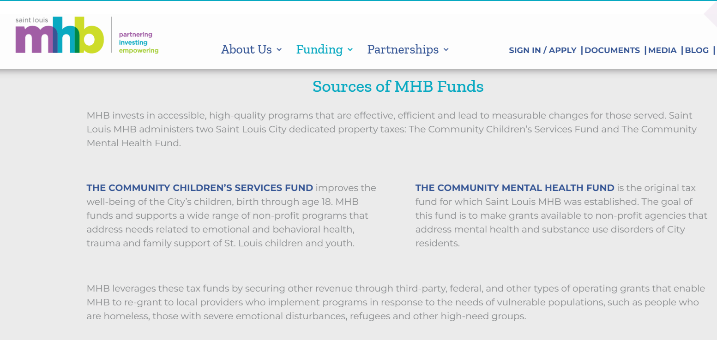
Our External Communication

Slide 14
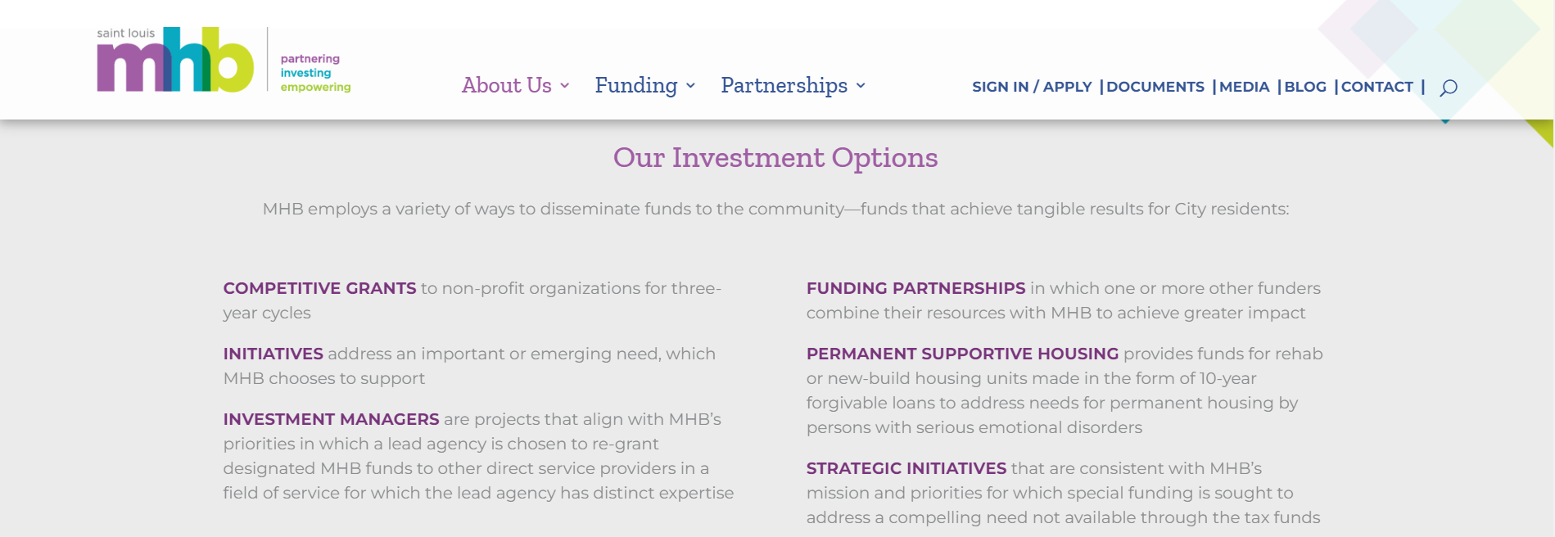
Our External Communication
Notes:
Our strategy to leverage external funds is communicated externally on our website

Slide 15
Current Practice
Currently, MHB leadership assesses opportunities to determine fit and alignment with MHB mission and strategy in consultation with our attorney before presenting options to our Trustee and Committees and Boards. We typically take the following into consideration –
Prioritize funding opportunities for which MHB is the best fit or only eligible entity to receive funding in order to minimize competition with nonprofit partners. (ex. Grants that require the applicant to be a unit of government)
Prioritize funding opportunities that advance the work of existing action plans and initiatives (ex. System of Care Strategic Financing Plan, St. Louis Area Violence Prevention Commission Action Plan, Aging & Behavioral Health Council)
Prioritize funding opportunities that pay for programs and services that would be ineligible to receive CCSF or CMHF funds (ex. Regional programs that serve the City and County)

Slide 16
Fiscal Sponsorship Models
BASIC CHARACTERISTICS | IS PROJECT A LEGAL ENTITY? | BASIC RELATIONSHIP | CHARITABLE DONATIONS RECEIVED BY | SPONSOR'S LIABILITY TO 3RD PARTIES | WHO FILES IRS RETURNS SPONSOR PROJECT |  | COMMENTS | MHB EXAMPLES
A. DIRECT PROJECT Project belongs to sponsor and is implemented by its employees and volunteers | No | Employer-employee | Sponsor | Total liability for acts of employees | 990; payroll tax returns | Individual employees file own 1040s | Legally, project is no different than any other activity carries on by sponsor directly | St. Louis Area Violence Prevention Commission (Multiple local foundation grants and pending SAMHSA Grant)
B. INDEPENDENT CONTRACTOR PROJECT Project belongs to sponsor but is conducted by separate entity under contract | Yes | Client-contractor | Sponsor | Varies, may be partial or total | 990; possibly 1099; depending on legal form of contractor | Depends on contractor's legal status | Project can be done by one independent contractor as service to sponsor. Less common than Models A and C | System of Care St. Louis Region SAMHSA Grant St. Louis Continuum of Care HUD Planning Grant (past) St. Louis Partnership Office of Refugee Resettlement grant (past) Mental Health and Housing Transformation SAMHSA Grant (past)
C. PREAPPROVED GRANT RELATIONSHIP Project applies to sponsor for one or a series of grants, sponsor funds project from money received from donors | Yes | Grantor-grantee | Sponsor | Liable for selection of project grantee, plus terms set by funders | 990: possibly 1099, depending on project legal form and grant circumstances | Depends on grantee's legal status | Used by non-501(c)(3) project entity to raise tax-deductible funds from donors, private foundations or government grants | City of St. Louis Office of Violence Prevention National League of Cities Municipalities Reimagining Community Safety Grant
F. TECHNICAL ASSISTANCE Project has own 501(c)(3) status, sponsor helps with bookkeeping, tax return, payroll, management, etc. | Yes | Service provider-client | Project | Only as provided in contract | 990, reports fees charged | 990, reports fees paid | Sponsor provides financial management to project, but all funds are raised and spent in name of project | St. Louis City Senior Fund

